Slide 1


NBA DASHBOARD
An Analysis of Factors that Affect NBA Team Wins
Team Members-
Yuan-Cheng Tsai
Gabe Owens
Shree Vidya Ravi Kumar
Arpan Shrivastava
Radhika Kumari
Notes:
Hi, this is group 2 and this is our final project for DSO545, our topic is “An Analysis of Factors that Affect NBA Team Wins”, our team member includes Gabriel, Shree Vidya, Arpan, Radhika and myself Yuan-Cheng.

Slide 2
ABSTRACT
This project analyzes the effects that certain “play-related” and “non-play-related” variables have on NBA team wins. Our data is gathered from each of the 30 NBA teams, for each of the 2013-2019 NBA seasons. We define “play-related” variables as team statistics recorded on the court of play during games (examples include rebounds or 3 point shooting percentage). We define “non-play-related” variables as statistics recorded outside the court of play (examples include tickets sold or team salary).
GOAL
Our goal is, through exploratory data analysis, to provide NBA executives and Team managers with specific advice/suggestions on ways to improve their total team wins.
Effects of Play and Non-Play Variables on NBA Team Wins
Notes:
To start with our abstract, our project focuses on analyzing the effects that Play-Related and Non-Play-Related Variables have on NBA Team wins.
Play-Related variables are defined as team statistics recorded on court during games, such as Rebounds or 3 Point Shooting Percentages
Non-Plat Related Variables, on the other hand, are defined as statistics recorded outside of courts, including Ticket sold or total team salary
As for our goal, our goal is to provide NBA executives and Team managers with specific advices or suggestions on ways to improve their total team wins.

Slide 3
Introduction
Why is our topic important?
Wins are a measure of team success
Why are Wins important?
Monetary gains
Social Influence
Reputational gains
Notes:
As an introduction to our project, we would like to start by answering two questions:
First, why is our topic important? Since Wins is one of the most important measures of team success in any professional sports league, improving wins would be greatly beneficial.
Second, why are wins important? Wins can contribute to more than just monetary gains, such as Ticket and Jersey Sales, it can generate Social Influence and Reputational gains, such as more social media followers, more television revenue, more primetime games, and more fans in general.

Slide 4
Overview
OBJECTIVE:
Our objective is to assist NBA teams and executives in their pursuit to win more games.
DATASET:
Our dataset records stats across 7 seasons (2013 to 2019), for all 30 NBA teams, and contains data on “Play-Related” and “Non-Play-Related” variables.
POTENTIAL USERS:
NBA Executives
Better viewing experience by understanding how each variable impact games
Team General Managers
Improve team construction/coaching to focus on statistics that directly improve wins
Avid NBA Fans
Will watch teams that are projected to win more games
Data Junkies
Enjoy dissecting and interpreting data for future use
Notes:
Our project overview covers the objective of our project, a basic introduction to our dataset and the projected potential users for our dashboard.
To start with our objective: Our objective is to assist NBA teams and executives in their pursuit to win more games.
As for our dataset, Our dataset records stats across 7 seasons (2013 to 2019), for all 30 NBA teams, and contains data on “Play-Related” and “Non-Play-Related” variables.
Then, our potential users: we believe that there are 4 type of people who would find our dashboard useful
first, NBA Executives hoping to better viewing experience for viewers
second, Team General Managers who wish to improve team construction and coaching
Third, NBA fans who will watch teams that are projected to have more wins
And last, Data junkies like us who Enjoy dissecting and interpreting data

Slide 5
EXPLORATORY
DATA ANALYSIS
Notes:
Now, we move on to our exploratory data analysis, to further understand how each variables interact with wins.

Slide 6
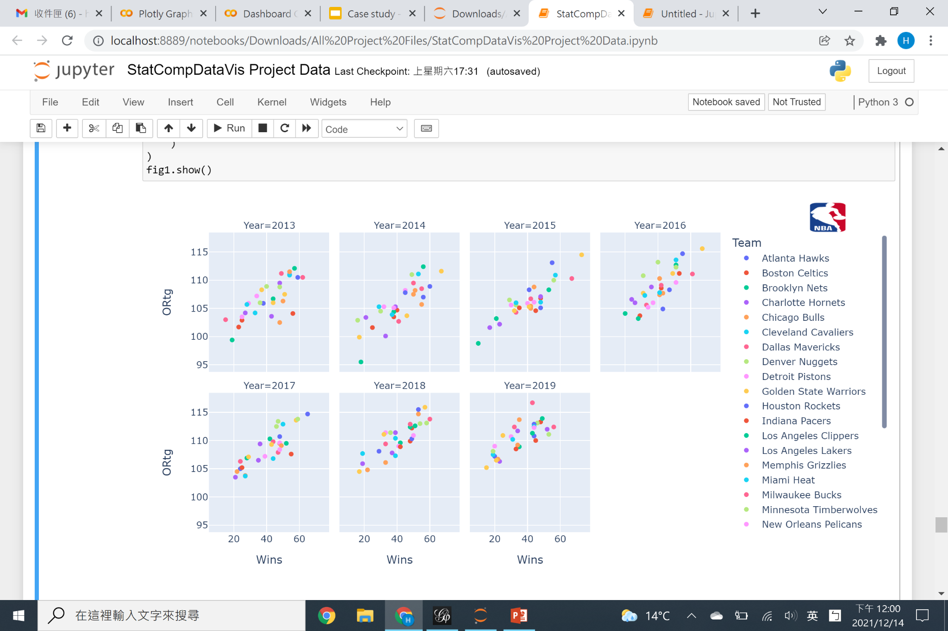
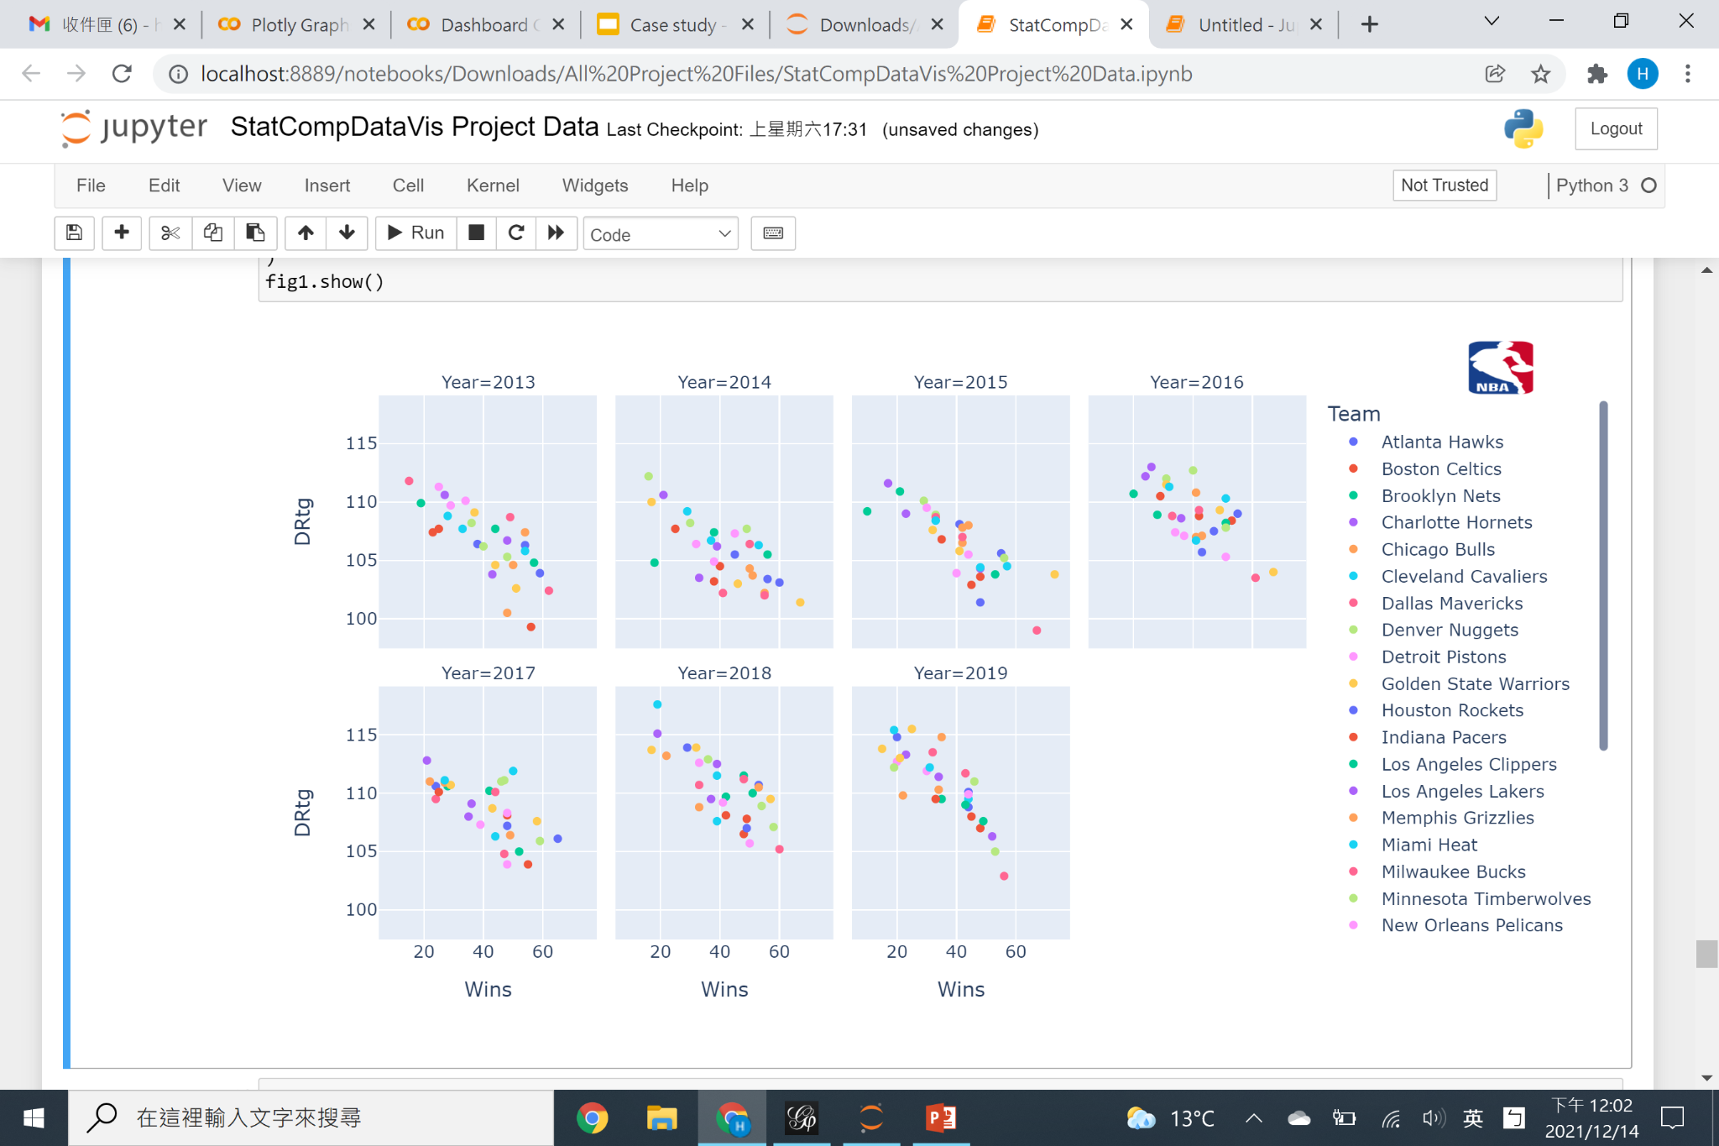
Wins vs Offensive and Defensive Rating
Offensive Rating and Wins
Positive Correlation: 0.65359
Defensive Rating and Wins
Negative Correlation: -0.659545
*Offensive rating is the amount of points produced by a team per 100 possessions of the ball.
*Defensive rating is how many points a team allows their opponent to score per 100 possessions.
Notes:
To start, we look at the effects of offensive and defensive ratings on wins:
Offensive rating is the amount of points produced by a team per 100 possessions of the ball.
There is a strong positive correlation (0.65359) between Offensive rating and Wins. This is logical as it means that as teams score more points more efficiently, they are more likely to win games.
Defensive rating, on the other hand, is how many points a team allows their opponent to score per 100 possessions.
There is a strong negative correlation (-0.659545) between DRtg and Wins. This is also logical and this means that as teams let their opponents score more and more frequently, they are less likely to win games.

Slide 7
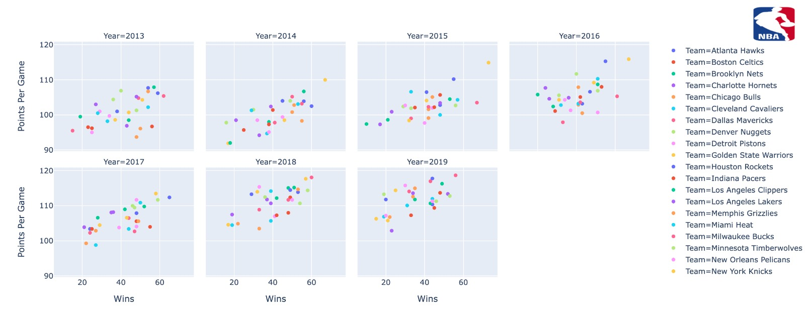
Wins vs Points Per Game across Years
Points Per Game and Wins
Positive Correlation: 0.350905
*Points Per Game means the average points scored per game by a team.
Notes:
Now, we look at the effects of points per game on wins:
Points Per Game means the average points scored per game by a team
We see a moderate positive correlation (0.350905) between Points per Game and Wins.This is logical because this means that as teams score more points, they are more likely to win games.

Slide 8
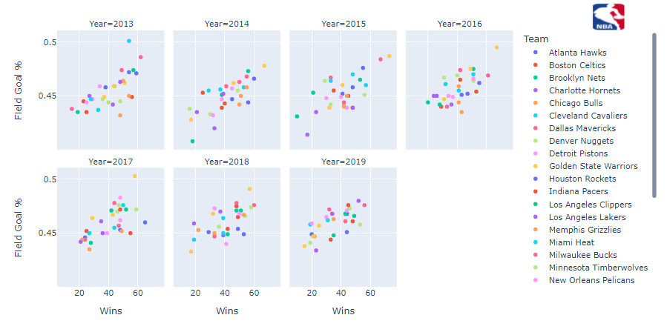
Wins vs Field goal%
Field Goal % and Wins
Positive Correlation: 0.619487
*Field Goal % indicates the average shots that went in of all shooting attempts per game.
Notes:
This is the effects of field goal percentage on wins:
Field Goal % indicates the average shots that went in of all shooting attempts per game.
There is a strong positive correlation (0.619487) between Field Goal % and Wins. This logically means that as total shooting percentage increases, the probability of winning increases as well.

Slide 9
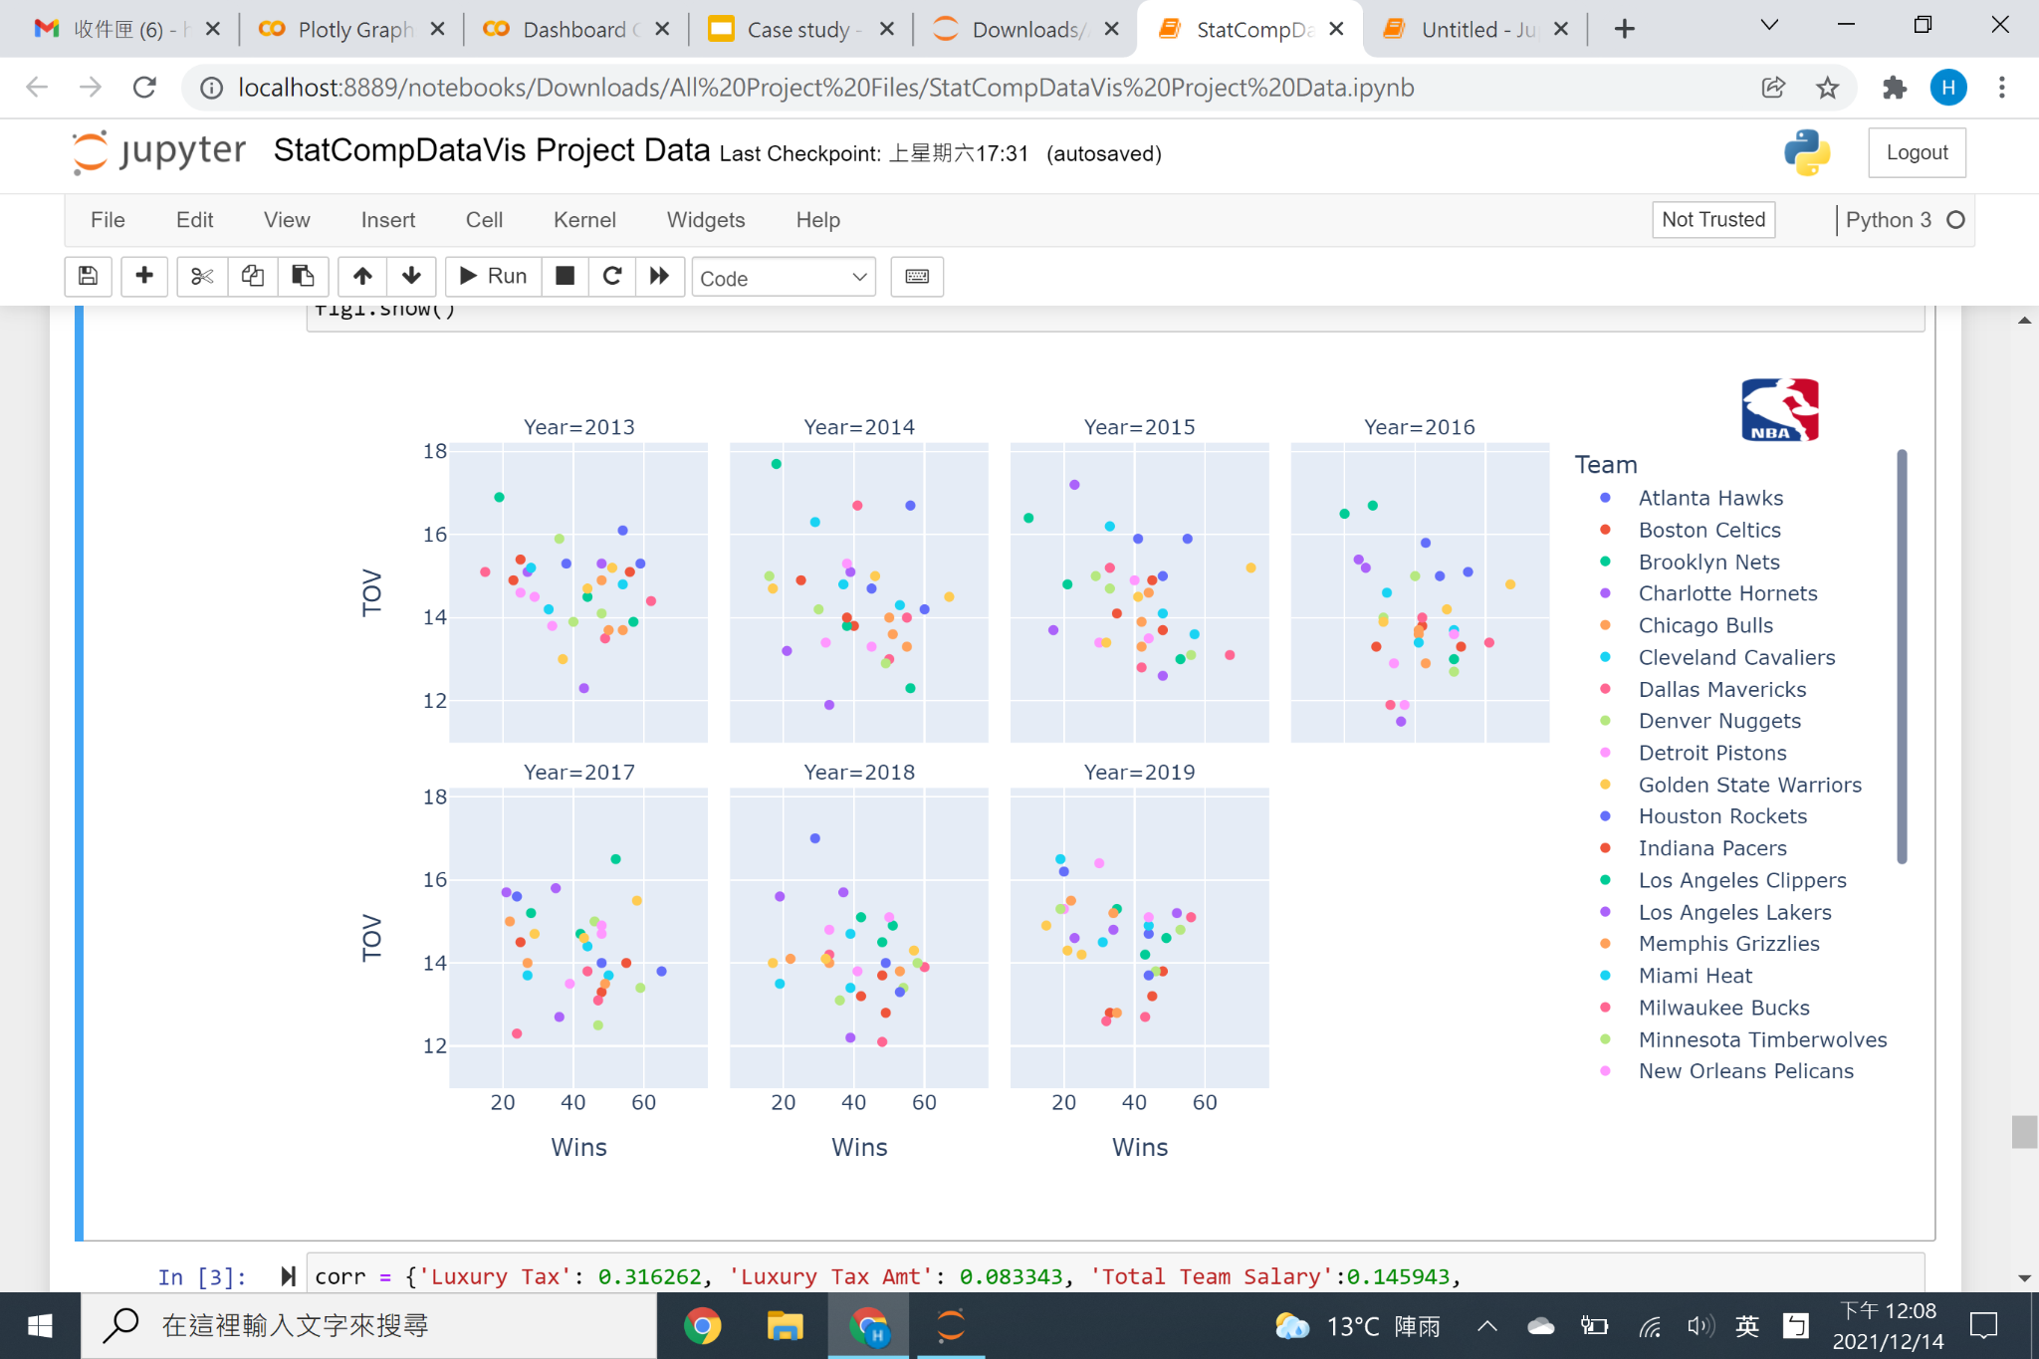
Wins vs Turnovers Per Game
Turnovers Per Game and Wins
Positive Correlation: 0.259778
*TOV, Average turnovers per game, is how many times the team loses possession of the ball to the opposing team before a shot is attempted
Notes:
On this slide, we look at the effects of TOV on wins:
TOV means Average turnovers per game, which is how many times the team loses possession of the ball to the opposing team before a shot is attempted
There is a moderate positive correlation between TOV and Wins (0.259778). This means that as teams lose possession of the ball more frequently before shooting, they will have less opportunities to score and thus, are less likely to win games.

Slide 10
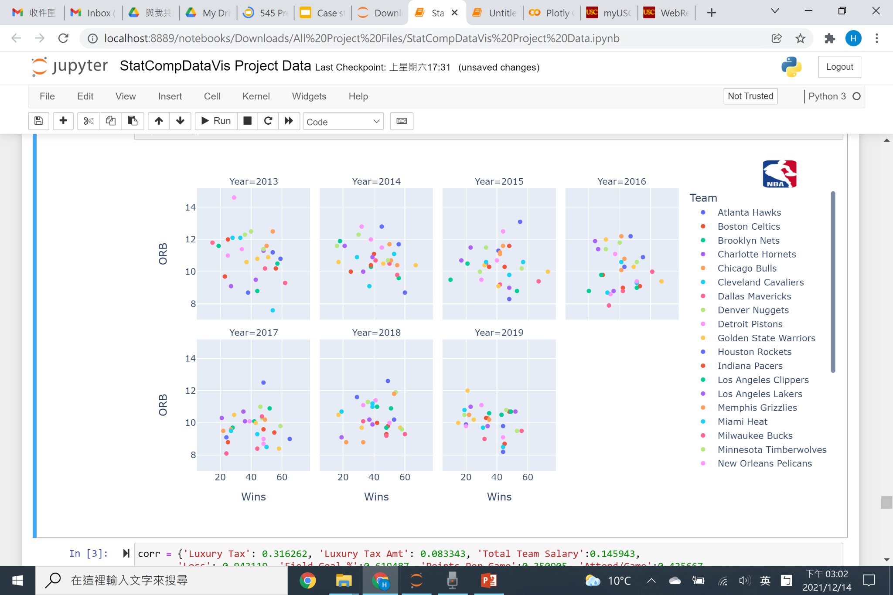
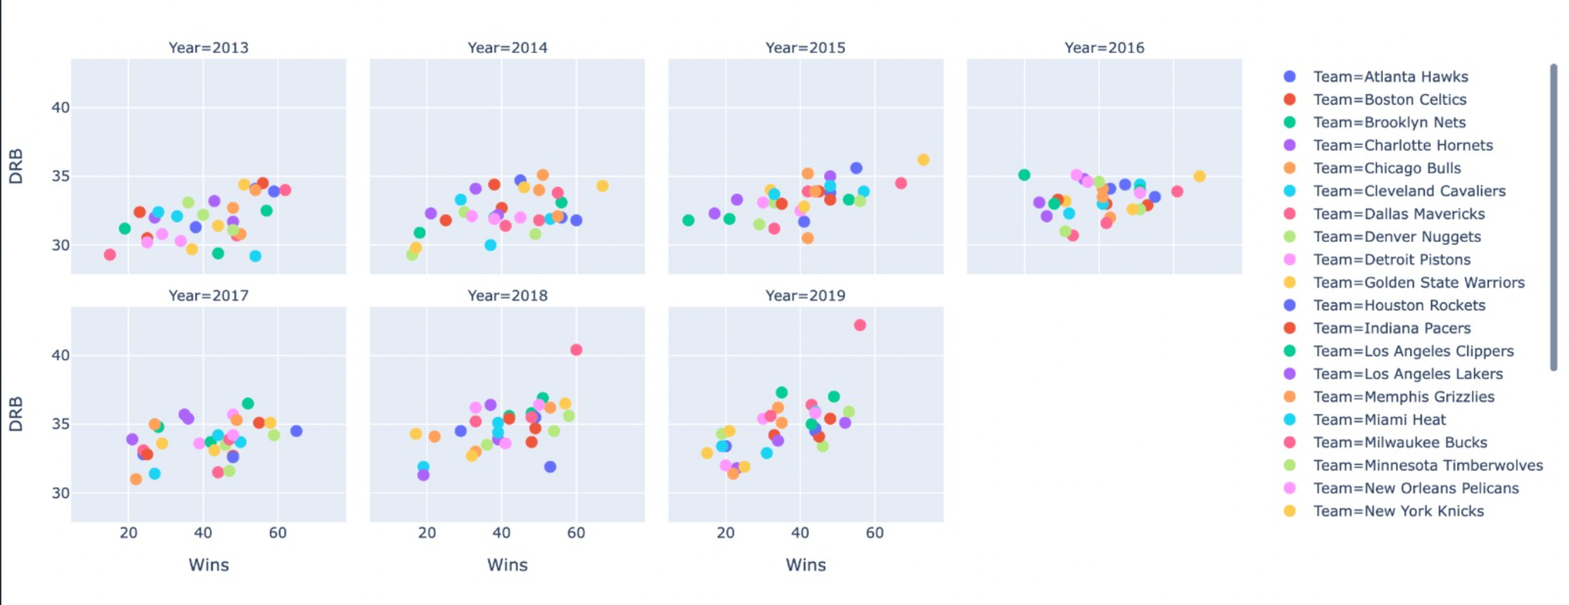
Wins vs Offensive and Defensive Rebound
Offensive Rebound and Wins
Negative Correlation: -0.117100
Defensive Rebound and Wins
Positive Correlation: 0.359936
*ORB, or Average offensive rebounds per game, means getting possession of their own missed shots back
*DRB, or Average defensive rebounds per game, means getting possession of their opponent’s missed shots
Notes:
This slide explores the effects of offensive and defensive rebound on wins:
ORB, or Average offensive rebounds per game, means getting possession of their own missed shots back
Offensive rebounds are slightly negatively correlated (-0.117100) with wins. This indicates that teams are ineffective at taking advantage of second chance opportunities.
DRB, or Average defensive rebounds per game, means getting possession of their opponent’s missed shots
Defensive rebounds are moderately positively correlated (0.359936) with wins. This means that teams are effective at quickly taking advantage of missed shots by the opposing team.

Slide 11
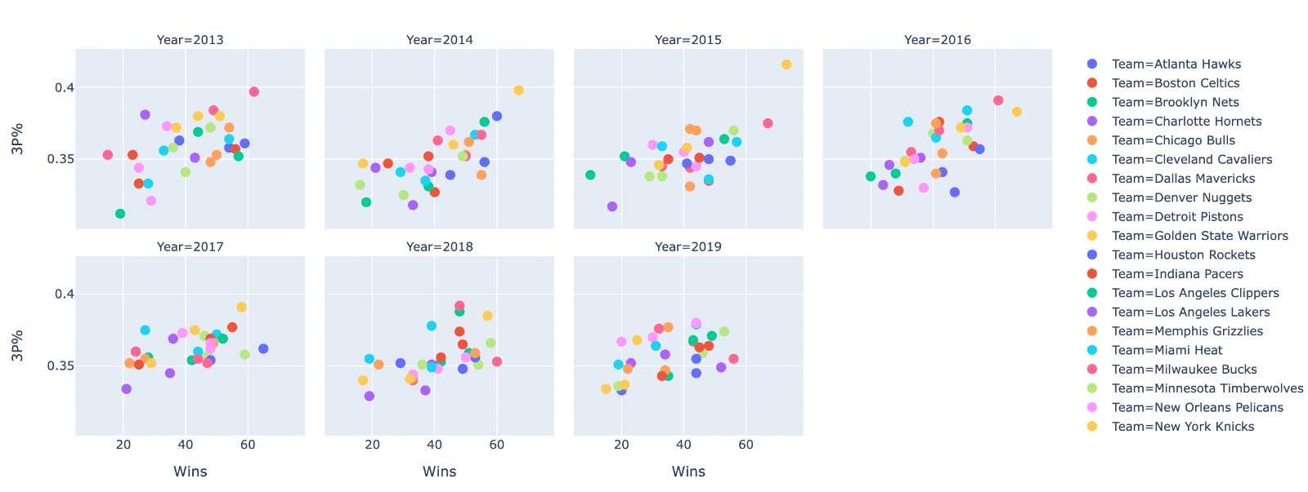
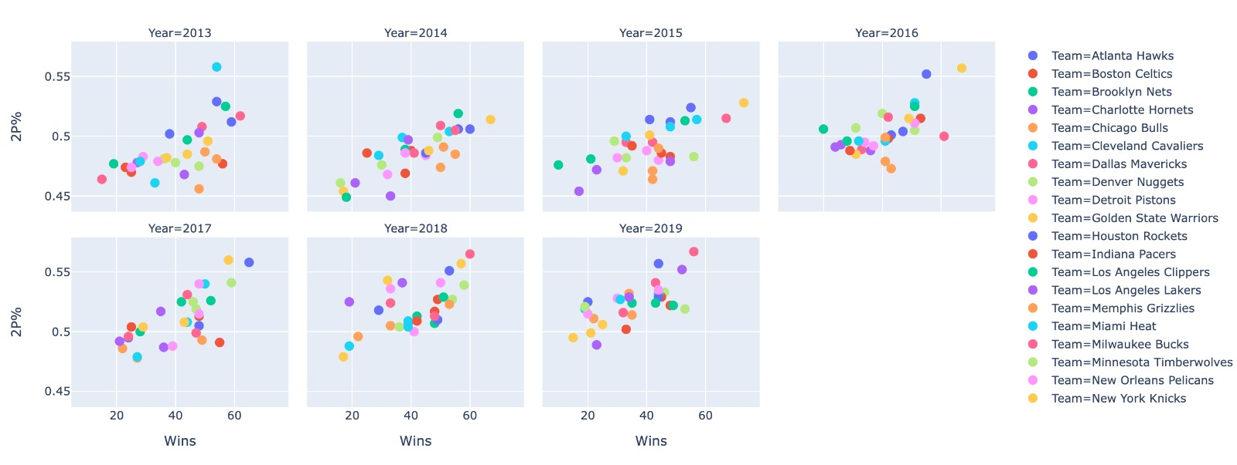
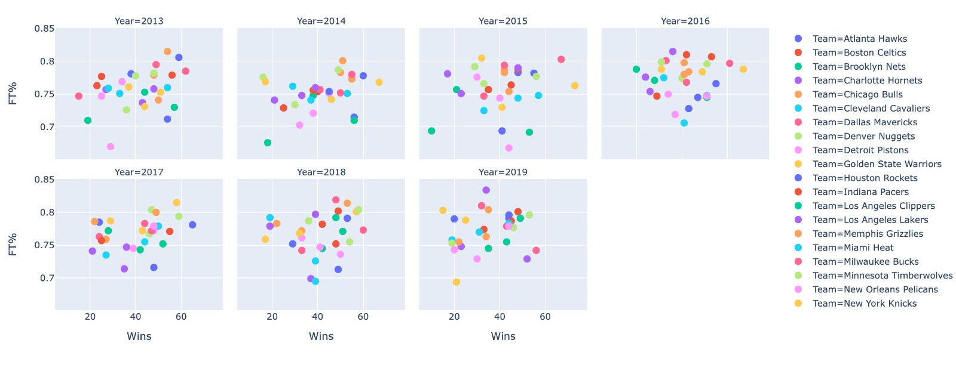
Wins vs Shooting Percentage
3P% and Wins
2P% and Wins
FT% and Wins
3P% and Wins
Positive Correlation: 0.547640
2P% and Wins
Positive Correlation: 0.475080
FT% and Wins
Positive Correlation: 0.188668
Notes:
On this slide, we explore shooting related percentages and their effects on wins:
3P%: For 3 point shooting percentage (3 points per shot)
There is a strong positive correlation with wins (0.547640)
2P%: For 2 point shooting percentage (2 points per shot)
There is a moderate positive correlation with wins. (0.475080)
FT%: free throw shooting percentage (1 point per shot)
There is a slight positive correlation with wins. (0.188668)
Out of all the shooting options, making 3 point shots clearly has the most significant influence on wins.

Slide 12
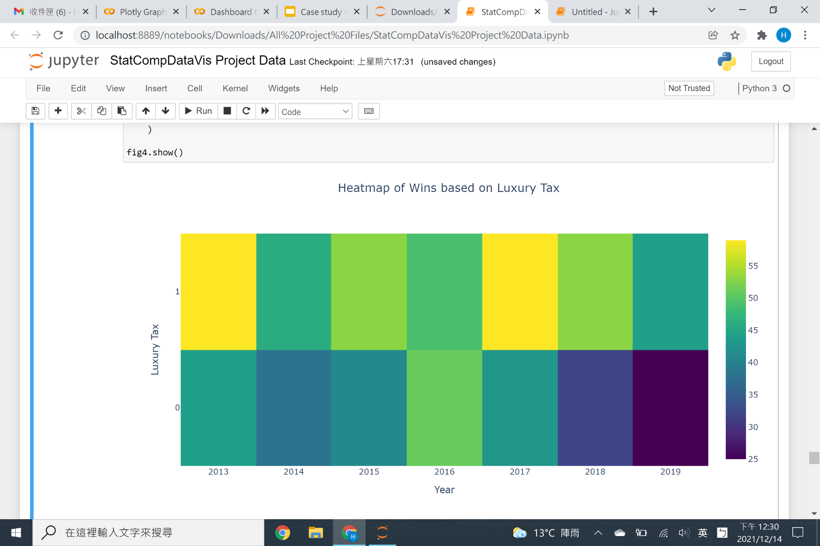
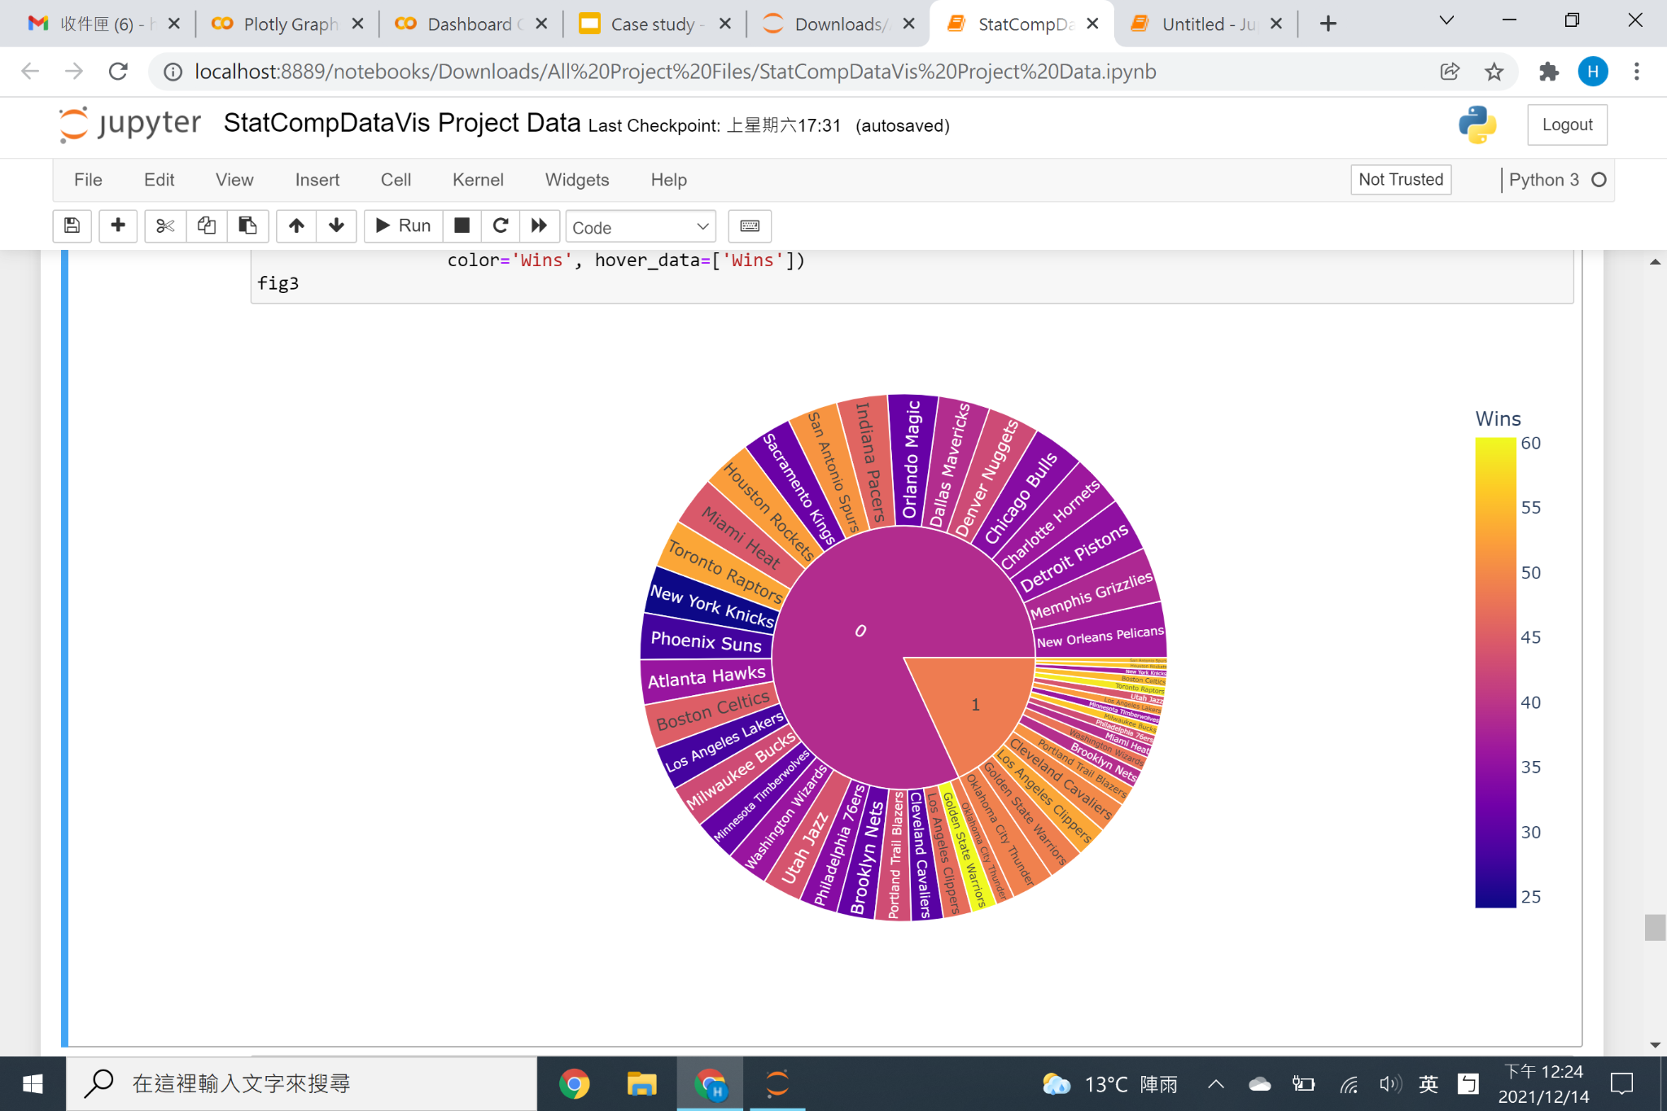
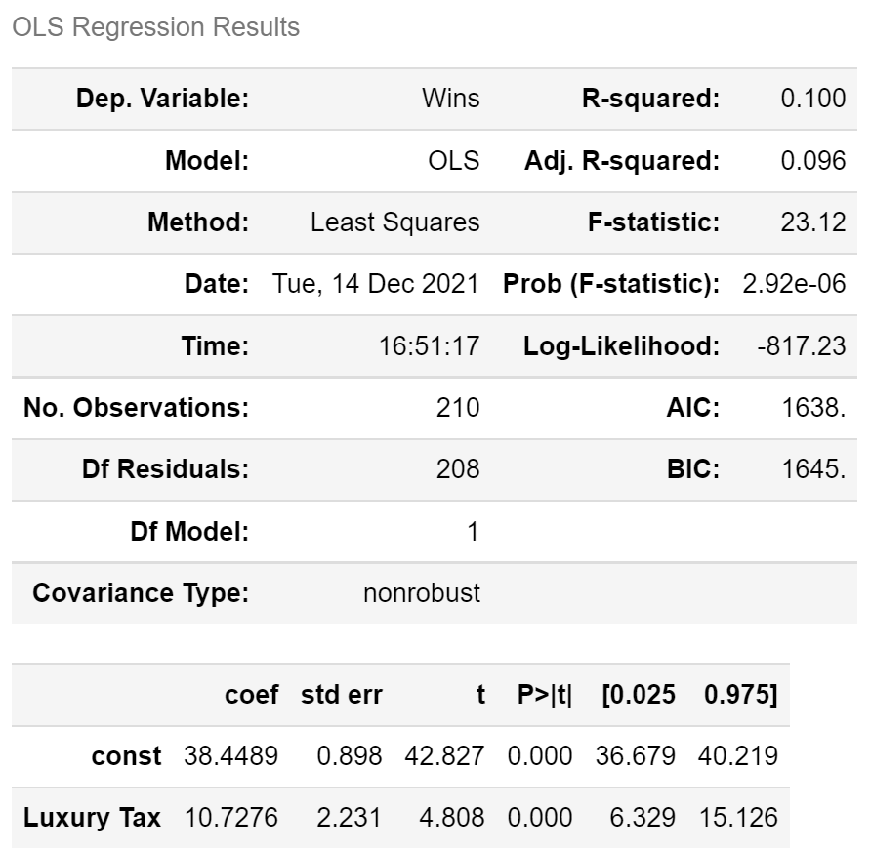
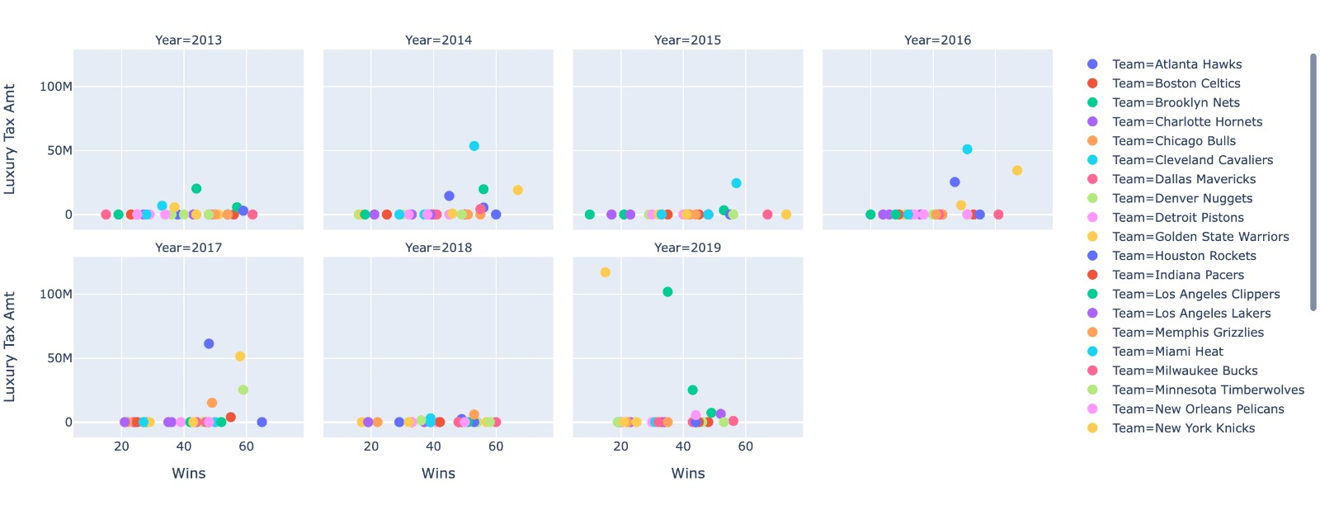
Wins vs Luxury Tax (Binary) vs Luxury Tax Amt (Millions)
Lux Tax and Wins
Positive Correlation: 0.31626
Lux Tax Amt and Wins
Positive Correlation: 0.083343
*Luxury Tax variable is a binary variable indicating whether the team paid luxury tax or not.
*Luxury Tax Amount variable indicates the total amount of luxury tax the team paid that year.
Notes:
Next, we look at the effects of luxury tax on wins:
First, some backstory, Luxury tax is a punishment for teams who have a total team salary above the League’s soft salary cap.
Our Luxury Tax variable is a binary variable indicating whether the team paid luxury tax or not.
We see a moderate positive correlation (0.31626) between Luxury Tax and Wins. This means that teams who pay luxury tax are more likely to win games. This can be explained by the fact that high salaries are paid to better players, and better players contribute to more wins. A team with more of these elite players will most likely have a total salary above the soft cap and will be forced to pay luxury tax, but will be rewarded with wins.
In addition, we ran regression analysis on this binary variable, and found that teams who pay luxury tax, on average, are expected to win 10.7276 more games than teams who don’t.
As for our Luxury Tax Amount variable, it indicates the total amount of luxury tax the team paid that year. Luxury tax is calculated via an incremental tax or bracket system. As an effort to promote fairness in the league by balancing teams with low and high capitals, tax amount increases with each increase in total salary paid to players. Luxury Tax payments are then redistributed across the league.
We see a slight positive correlation (0.083343) between Luxury Tax Amount and Wins. This means that as teams spend more into the luxury tax, they are slightly more likely to win games.

Slide 13
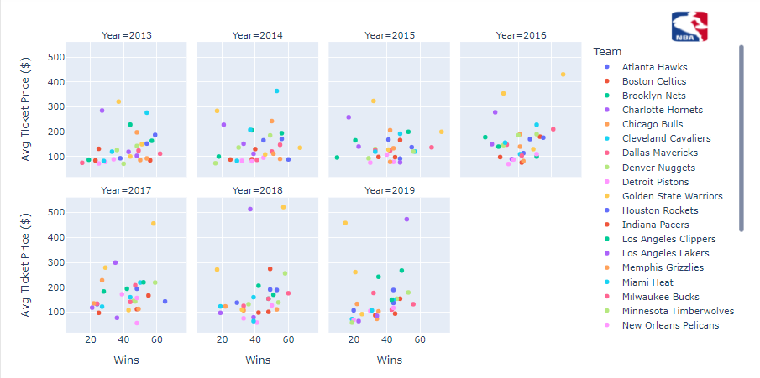

Wins vs Avg Ticket Price ($) vs Ticket Sold (Millions)
Avg Ticket Price and Wins
Positive Correlation: 0.161796
Tickets Sold and Wins
Positive Correlation: 0.214550
*Average ticket price means the Average resale ticket price for a seat in the team's stadium.
*Tickets Sold (Millions) are Total tickets sold for all games.
Notes:
This slide explores the effects of ticket related variables on wins:
First, Average Ticket Price. Average ticket price means the Average resale ticket price for a seat in the team's stadium
There is a slight positive correlation between Average Ticket Price (0.161796) and Wins.
Second, Tickets Sold, which are Total tickets sold for all games
There is a slight positive correlation (0.214550) between Tickets Sold and Wins.
Hence, we can infer that as teams win more games, the viewing experience becomes more attractive, and the demand to watch a team grows, total tickets sold will increase and the franchise can respond by increasing ticket prices.
.

Slide 14
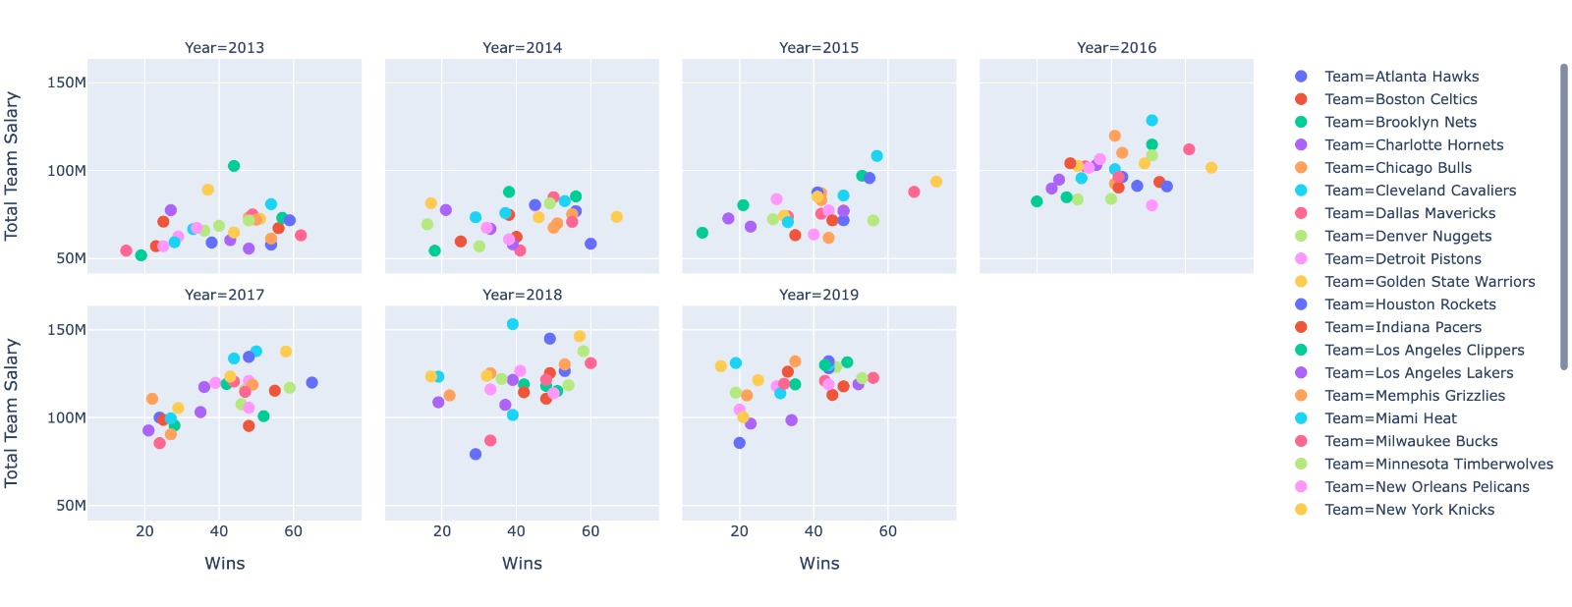
Wins vs Total Team Salary
Total Team Salary and Wins
Positive Correlation: 0.145943
*Total Team Salary is the Total combined salaries of all players on the team
Notes:
For this slide, we look at total team salary and wins:
Total Team Salary is the Total combined salaries of all players on the team
There is a slight positive correlation (0.145943) between Total Team Salary and Wins, meaning as teams pay more for better or more valuable players, they are more likely to win games as a result of them.

Slide 15
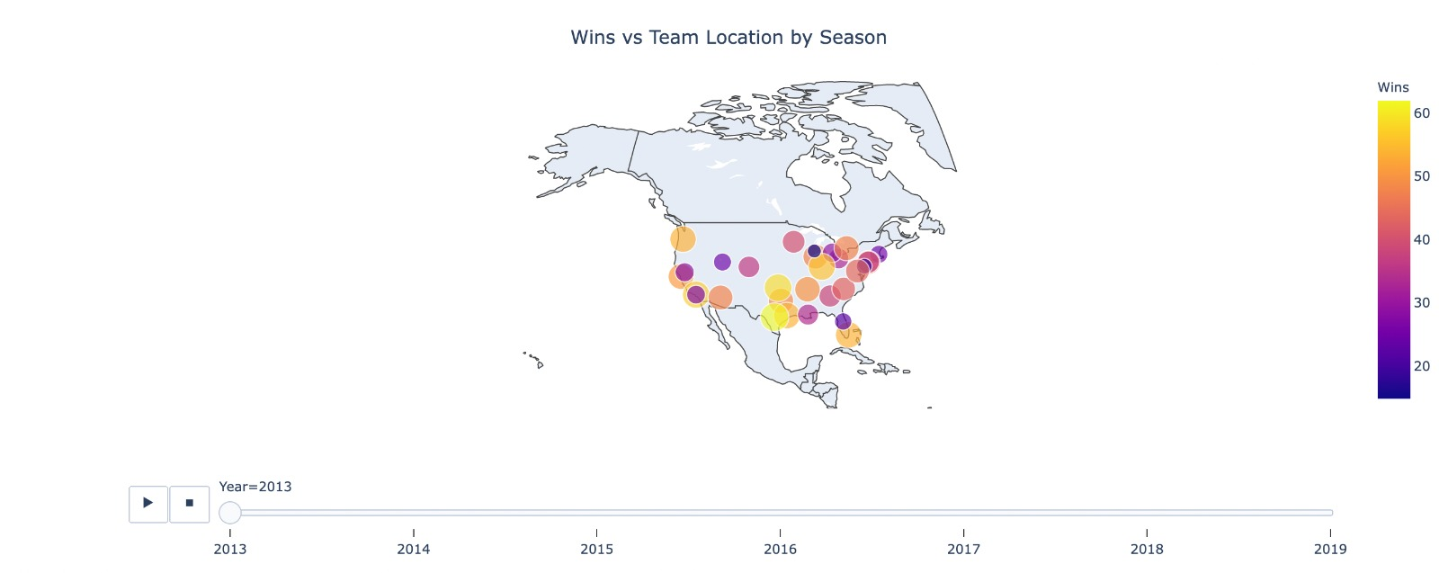
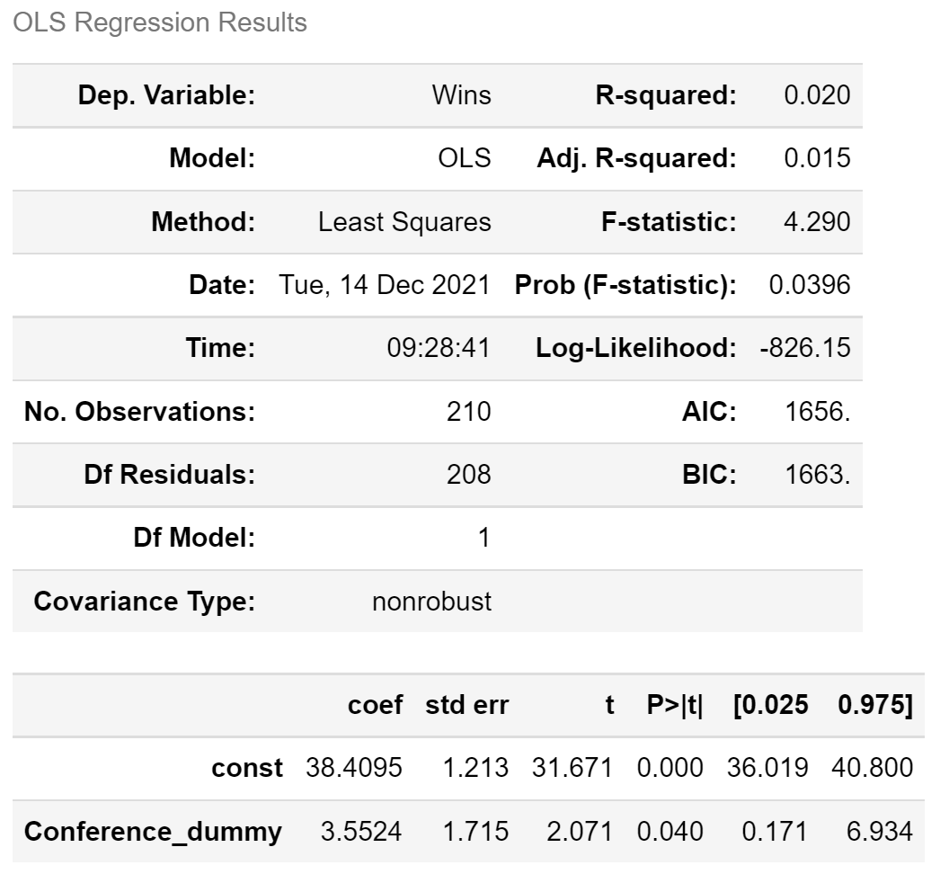
Wins vs Team by Location
Wins on each team based on Geographic Location
East/ West Regression Result
Notes:
This graph shows the relative amount of wins for each team based on their geographic location, for each season.
To analyze the effect of location, we created a dummy variable for the two conference (Eastern = 0, Western= 1).
We can see that if a team is in the Western Conference (or located in Western US), they will have an expected 3.5524 more Wins than if they were in the Eastern Conference (or located in the Eastern US). This value is significant at the alpha=.05 level. This indicates that it is harder for teams in the Western Conference to make it to the playoffs, as they need more wins to qualify for a spot, when compared to their eastern counterparts.

Slide 16
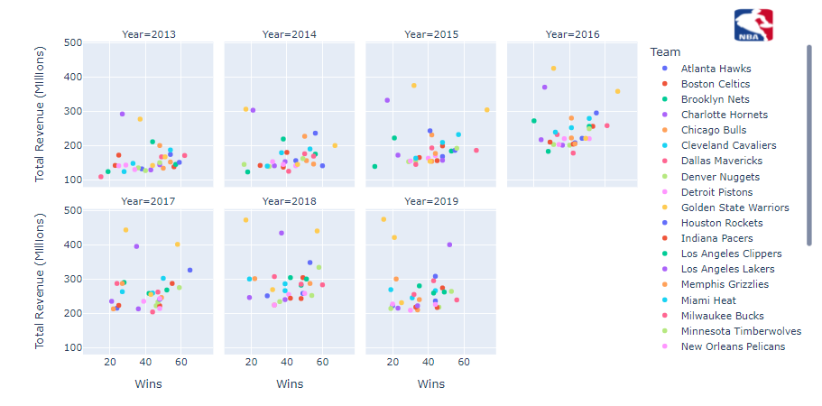
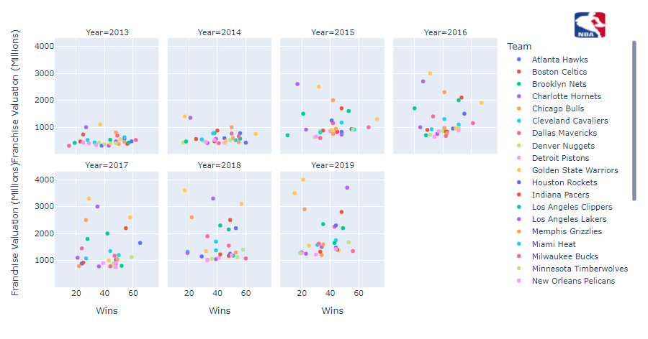
Wins vs Total Revenue vs Franchise Valuation
(Millions)
Total Revenue and Wins
Negative Correlation: -0.011488
Franchise Valuation and Wins
Negative Correlation: -0.104385
*Total revenue is the revenue for that team in that year (from all revenue sources).
*Tickets Sold (Millions) are the Total tickets sold for all games.
Notes:
For this slide, we look at the effects of total revenue and franchise valuation on wins:
Total Revenue: Total revenue for that team in that year (from all revenue sources)
There is a slight negative correlation between Total Revenue and Wins (-0.011488).
Franchise Valuation: Valuation of the team/franchise at end of that year
There is a slight negative correlation between Franchise Valuation and Wins (-0.104385).

Slide 17
Revenue vs Franchise vs Legacy
LA Lakers
New York Knicks
LA Lakers
New York Knicks
LA Lakers
New York Knicks
Golden State Warriors
LA Lakers
New York Knicks
Golden State Warriors
Visual Representation of outliers as a result of the legacy/location phenomenon in NBA.
Notes:
Both of these negative correlations can be attributed to the phenomenon of all major sports leagues: Legacy Teams and Team Locations. Teams with a history of success and notoriety, or simply those located in a major city will skew these values because of their natural allure and appeal. Such as the New York Knicks and the Los Angeles Lakers.

Slide 18
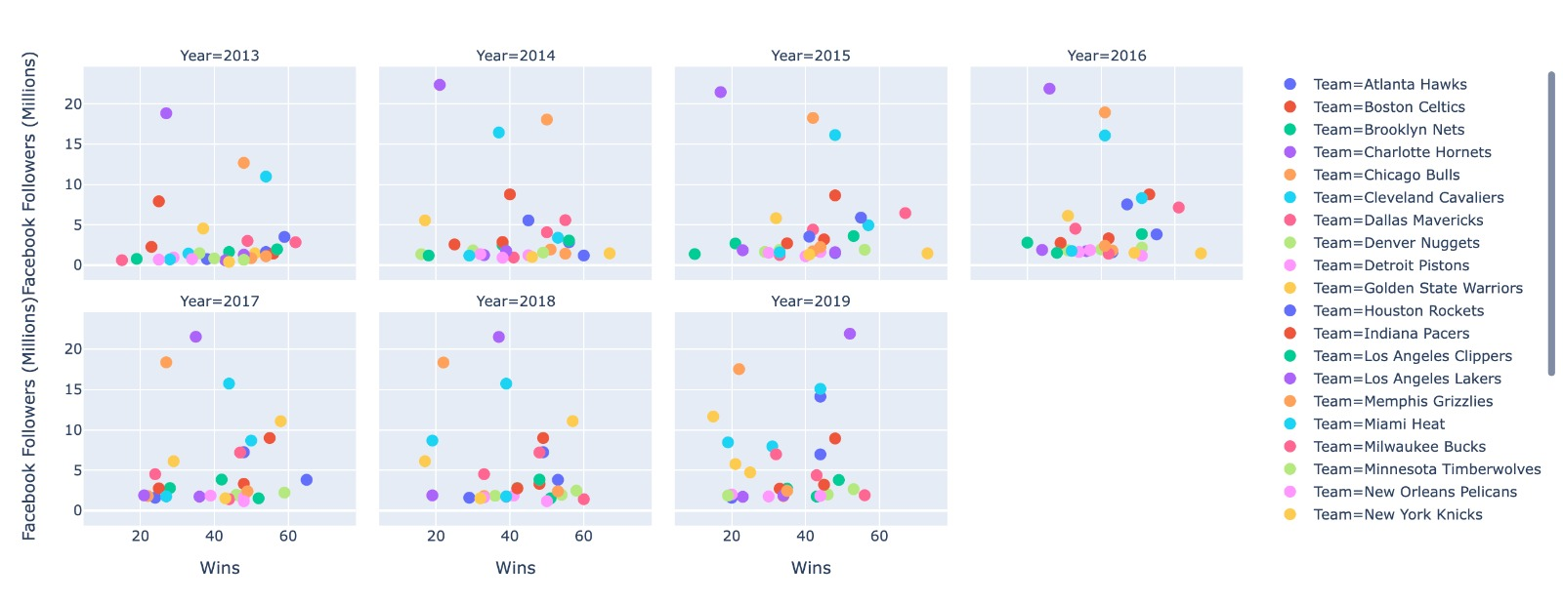
Wins vs Social Media Followers
Chicago Bulls
Facebook Followers and Wins
Negative Correlation: -0.064933
Twitter Followers and Wins
Negative Correlation: -0.042298
*Facebook/Twitter Followers: the amount of followers for each team at the end of the year
Notes:
This slide explores the relation of social media followers on wins:
Facebook/Twitter Followers: the amount of followers for each team at the end of the year (for each respective social media platform).
We see that the trend between total wins and the number of social media followers on each platform has slight negative correlation.
Facebook : -0.064933
Twitter : -0.042298
This can also be explained by the legacy phenomenon of team sports. Teams with significant legacy and history will skew this data. An example of an outlier in this case is the Chicago Bulls, who are living off the legacy of Michael Jordan.

Slide 19
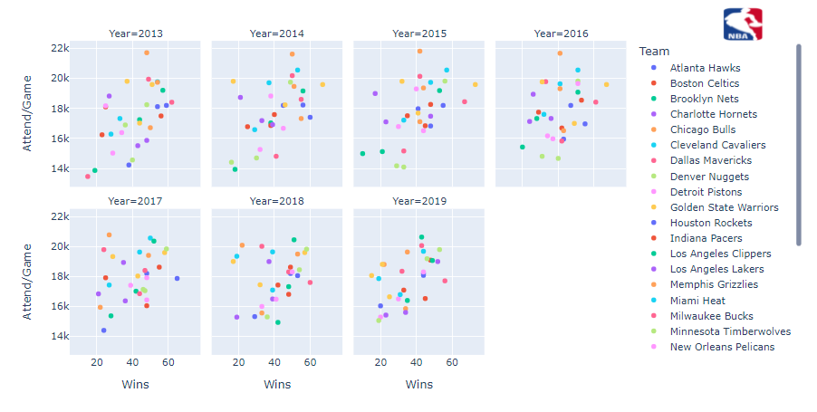
Wins vs Attend/Games
Attendance Per Game and Wins
Positive Correlation: 0.425667
*Attendance per game is the Average stadium attendance per game.
Notes:
On this slide we see the relations between attendance per game and wins:
Attendance per game is the Average stadium attendance per game
We see a moderate positive correlation (0.425667). This can logically be explained by the fact that fans want to watch their team win, and will fill more seats in the stadium as winning improves.
Another explanation could be home court advantage, when fan attendance is high, it can have a major role in boosting player morale and can contribute to better plays on the court, and thus, more wins.

Slide 20

DASHBOARD

Slide 21
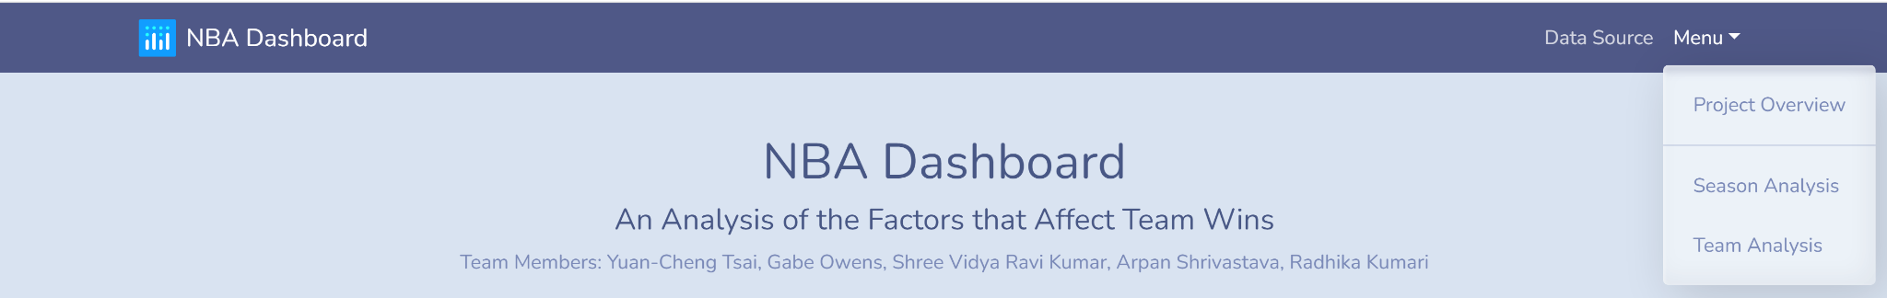
Dashboard (General Layout)
Navbar
Navigate through pages
Project Overview/Home Page
Relevant Info/Overview
Season Analysis (Page 1)
Per-Season EDA
Team Analysis (Page 2)
Per-Team EDA
Conclusions

Slide 22
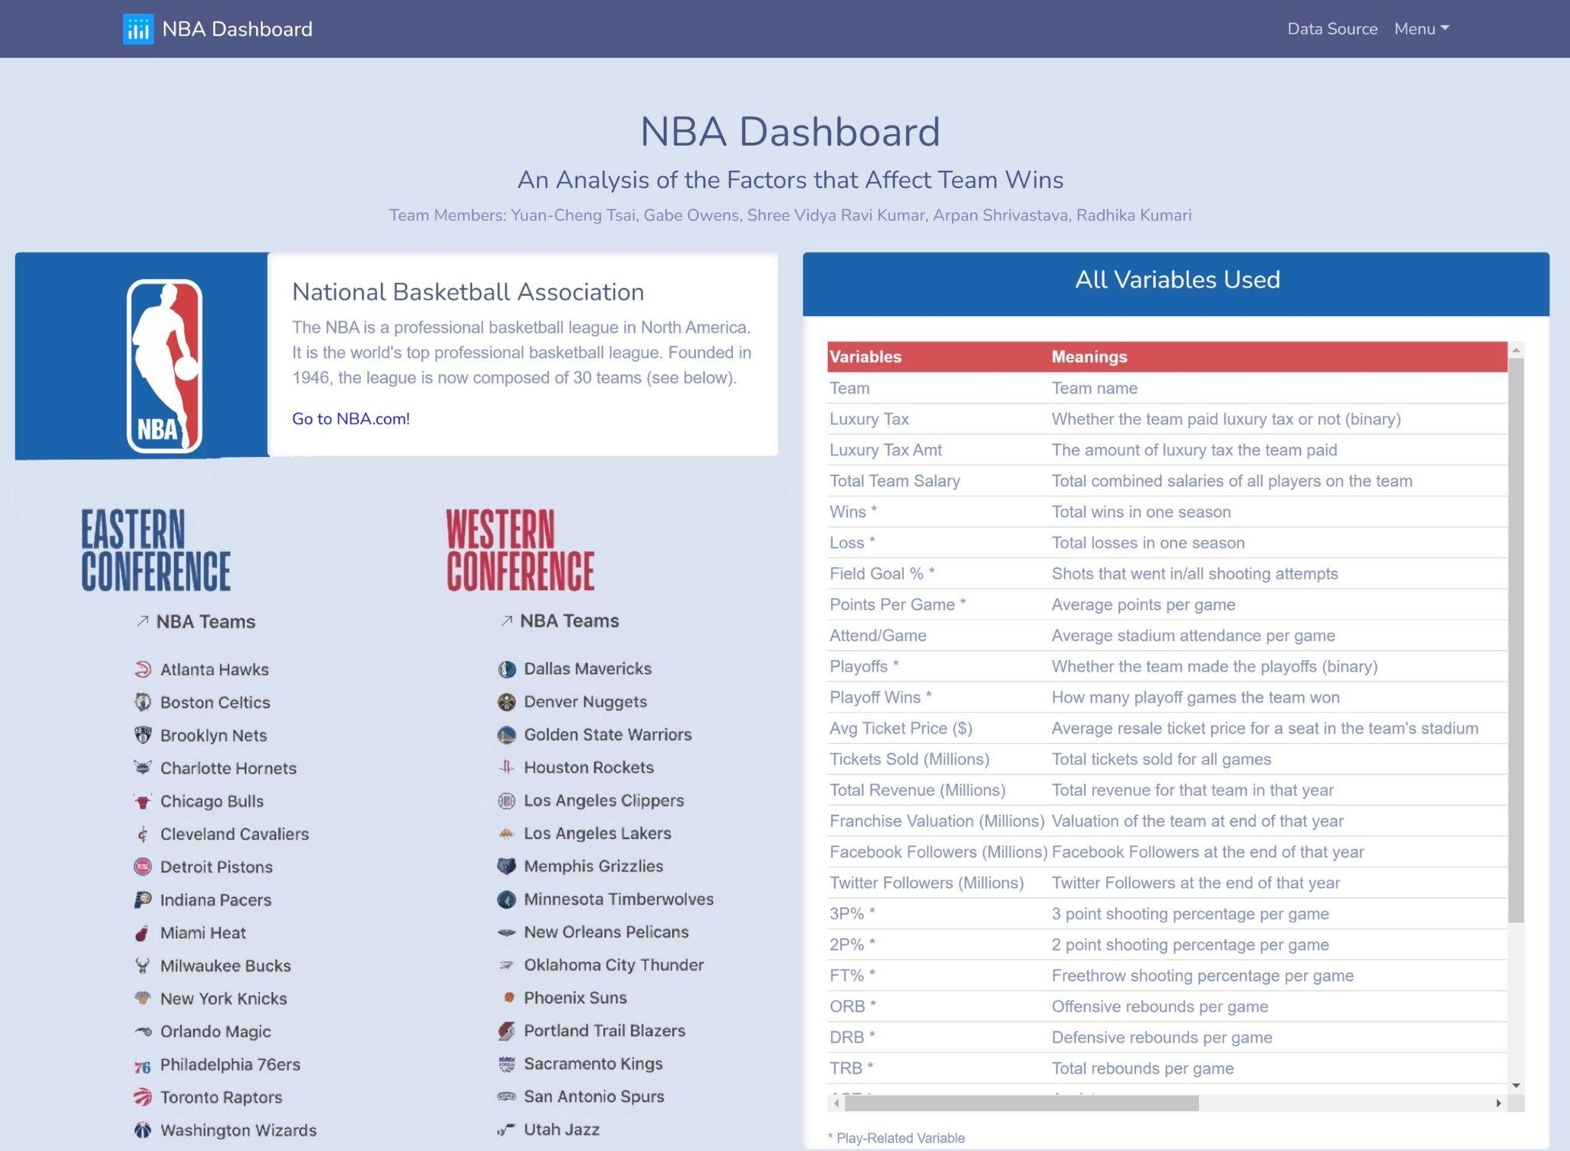
Homepage
Content:
Definition of the league
Link to league website(NBA.com)
List of all 30 teams and their respective conferences
Interactive data table with all of our used variables
* = Play-Related Variable

Slide 23
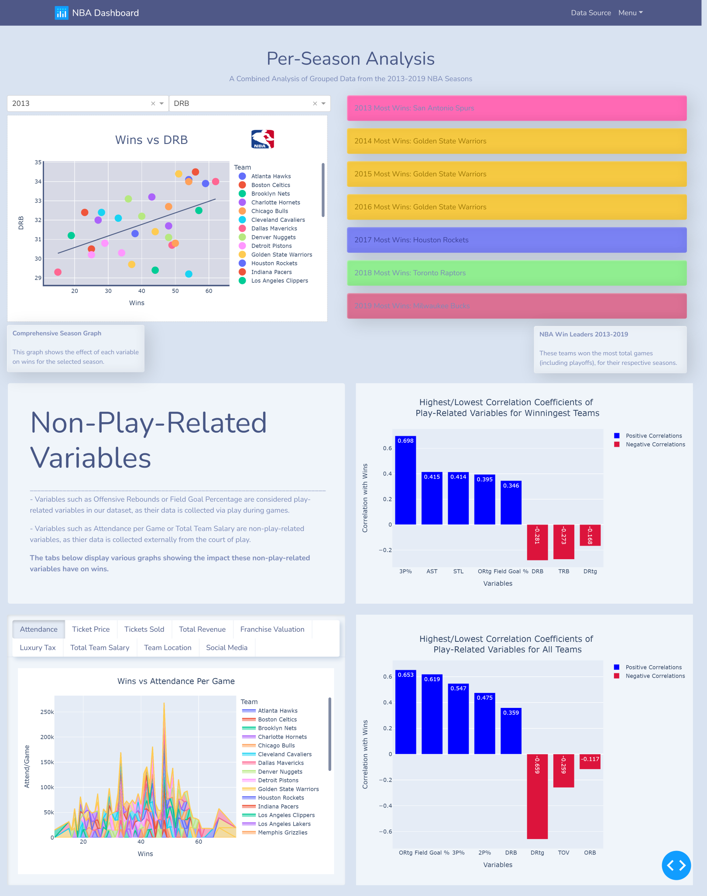
Season Analysis (Page 1)

Slide 24
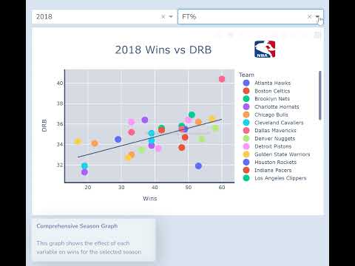
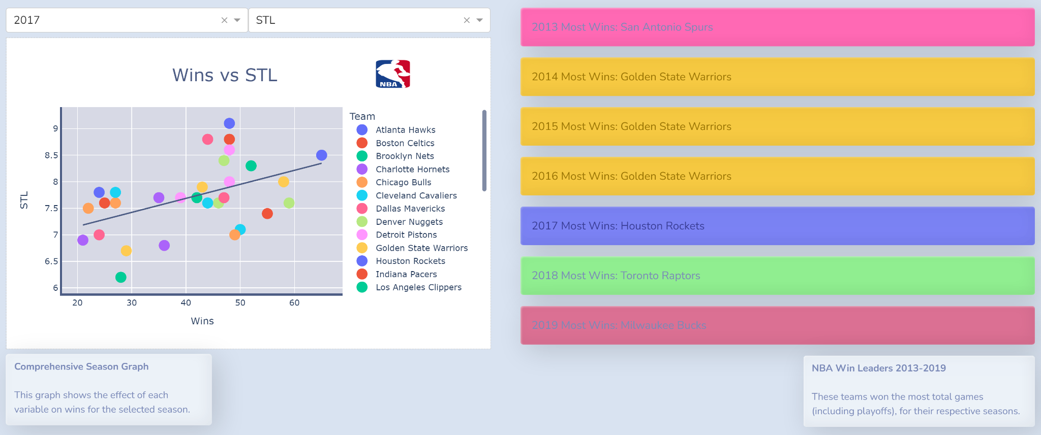
Season Analysis (Page 1)
Content:
Comprehensive Per-Season Scatterplot (2013-2019)
OLS trendline displayed (Hover: shows Correlation Coefficient)
Scatterplot markers (Hover: display relevant info)
Team Badges:
The right-hand badges show the teams with the most wins for each season (2013-2019)
Each badge color corresponds to the specific team color on the interactive graph

Slide 25
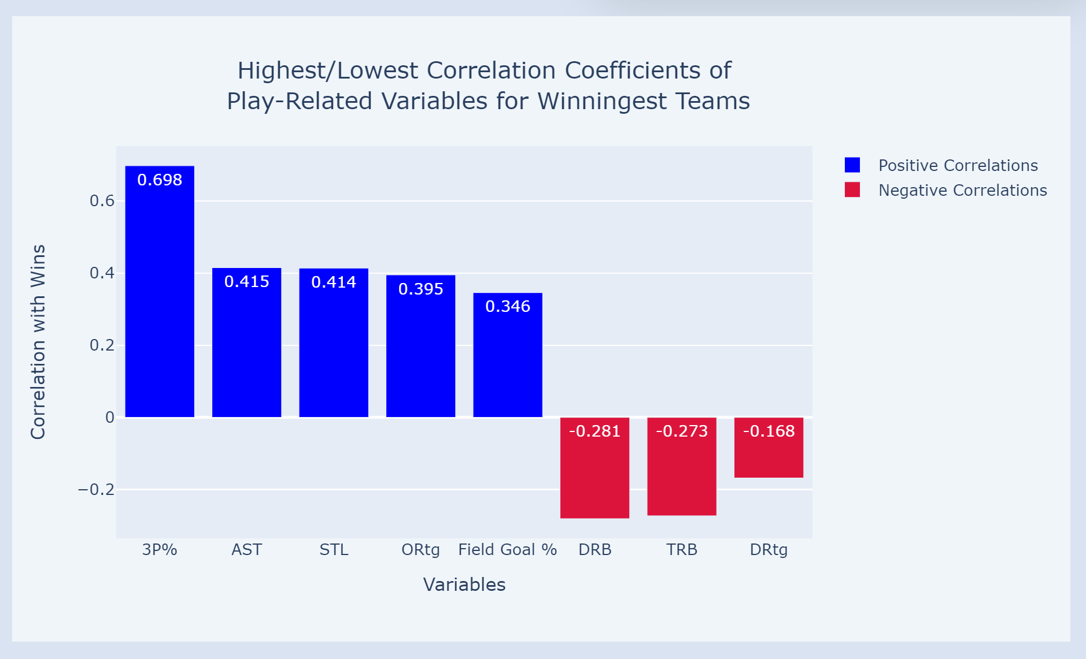
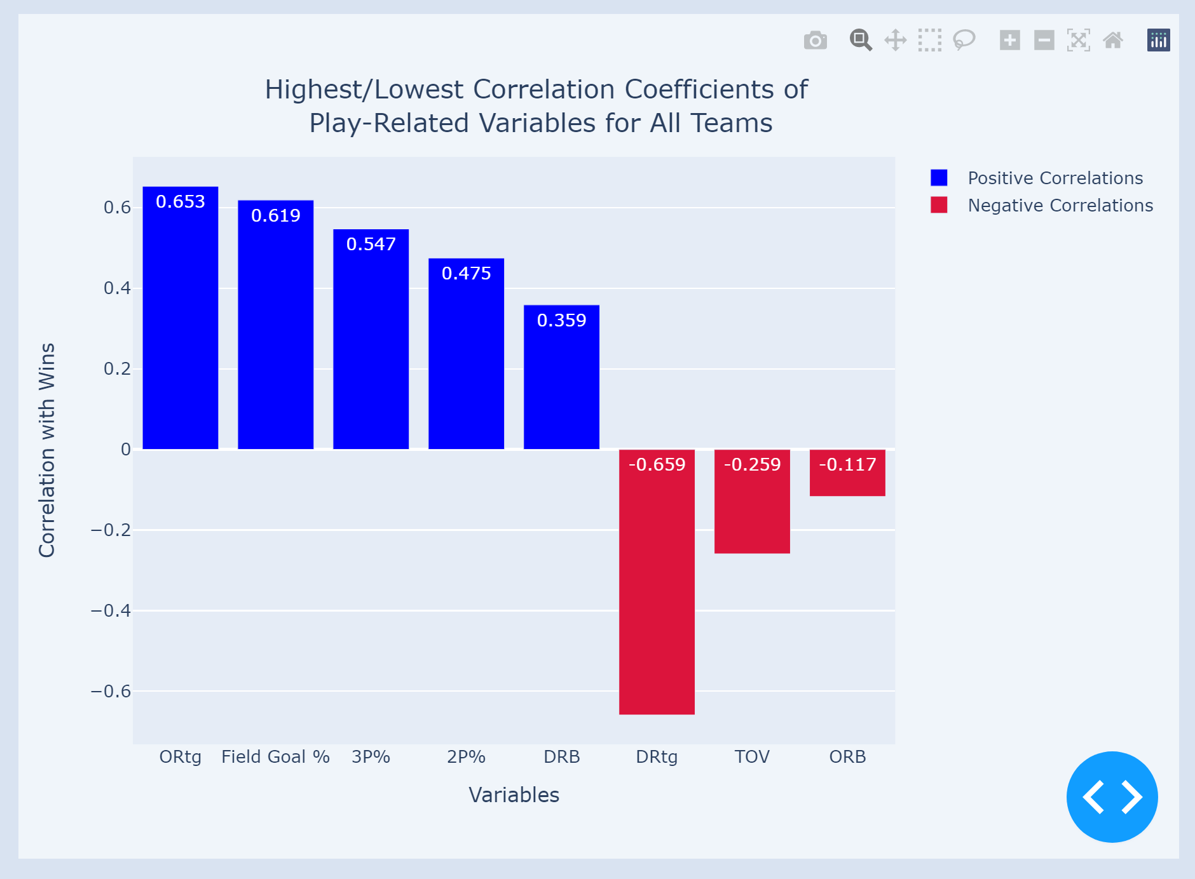
Season Analysis (Page 1)
Winningest Teams’ Highest Positive and Lowest Negative Correlation Coefficients for Play Related Variables
All Teams’ Highest Positive and Lowest Negative Correlation Coefficients for Play-Related Variables
3P% = .698
AST =. 415
STL = .414
ORtg = .395
Field Goal % = .346
DRB = -.281
TRB = -.273
DRtg = -.168
ORtg = .653
Field Goal % = .619
3P% = .547
2P% = .475
DRB = .359
DRtg = -.659
TOV = -.259
ORB = -.117
Notes:
The point of displaying these two graphs is to show the users which variables show up once, twice, or not at all and to compare the magnitude of their effect on wins for both the group of just the winningest teams and for the group of all teams combined.

Slide 26
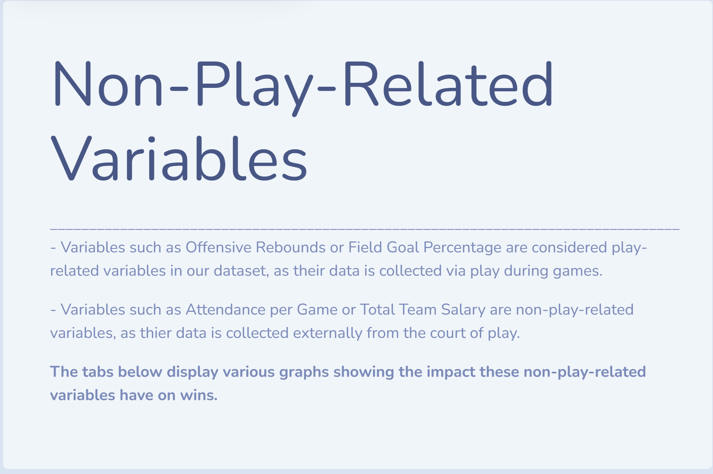
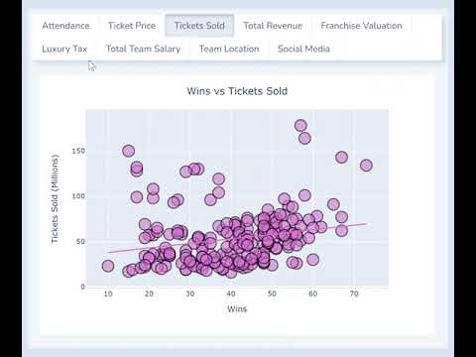
Season Analysis (Page 1)
Non-Play Related Variable Analysis:
Separate Analysis of “non-play-related” variables
Each tab displays a chart showing the relationship between that specific variable and wins
Video Content:
The type of chart varies from tab to tab (with the majority being scatterplots)
This video highlights the tabs with unique graph styles
Notes:
The point of this was to segment non-play-related variables from play-related variables.

Slide 27
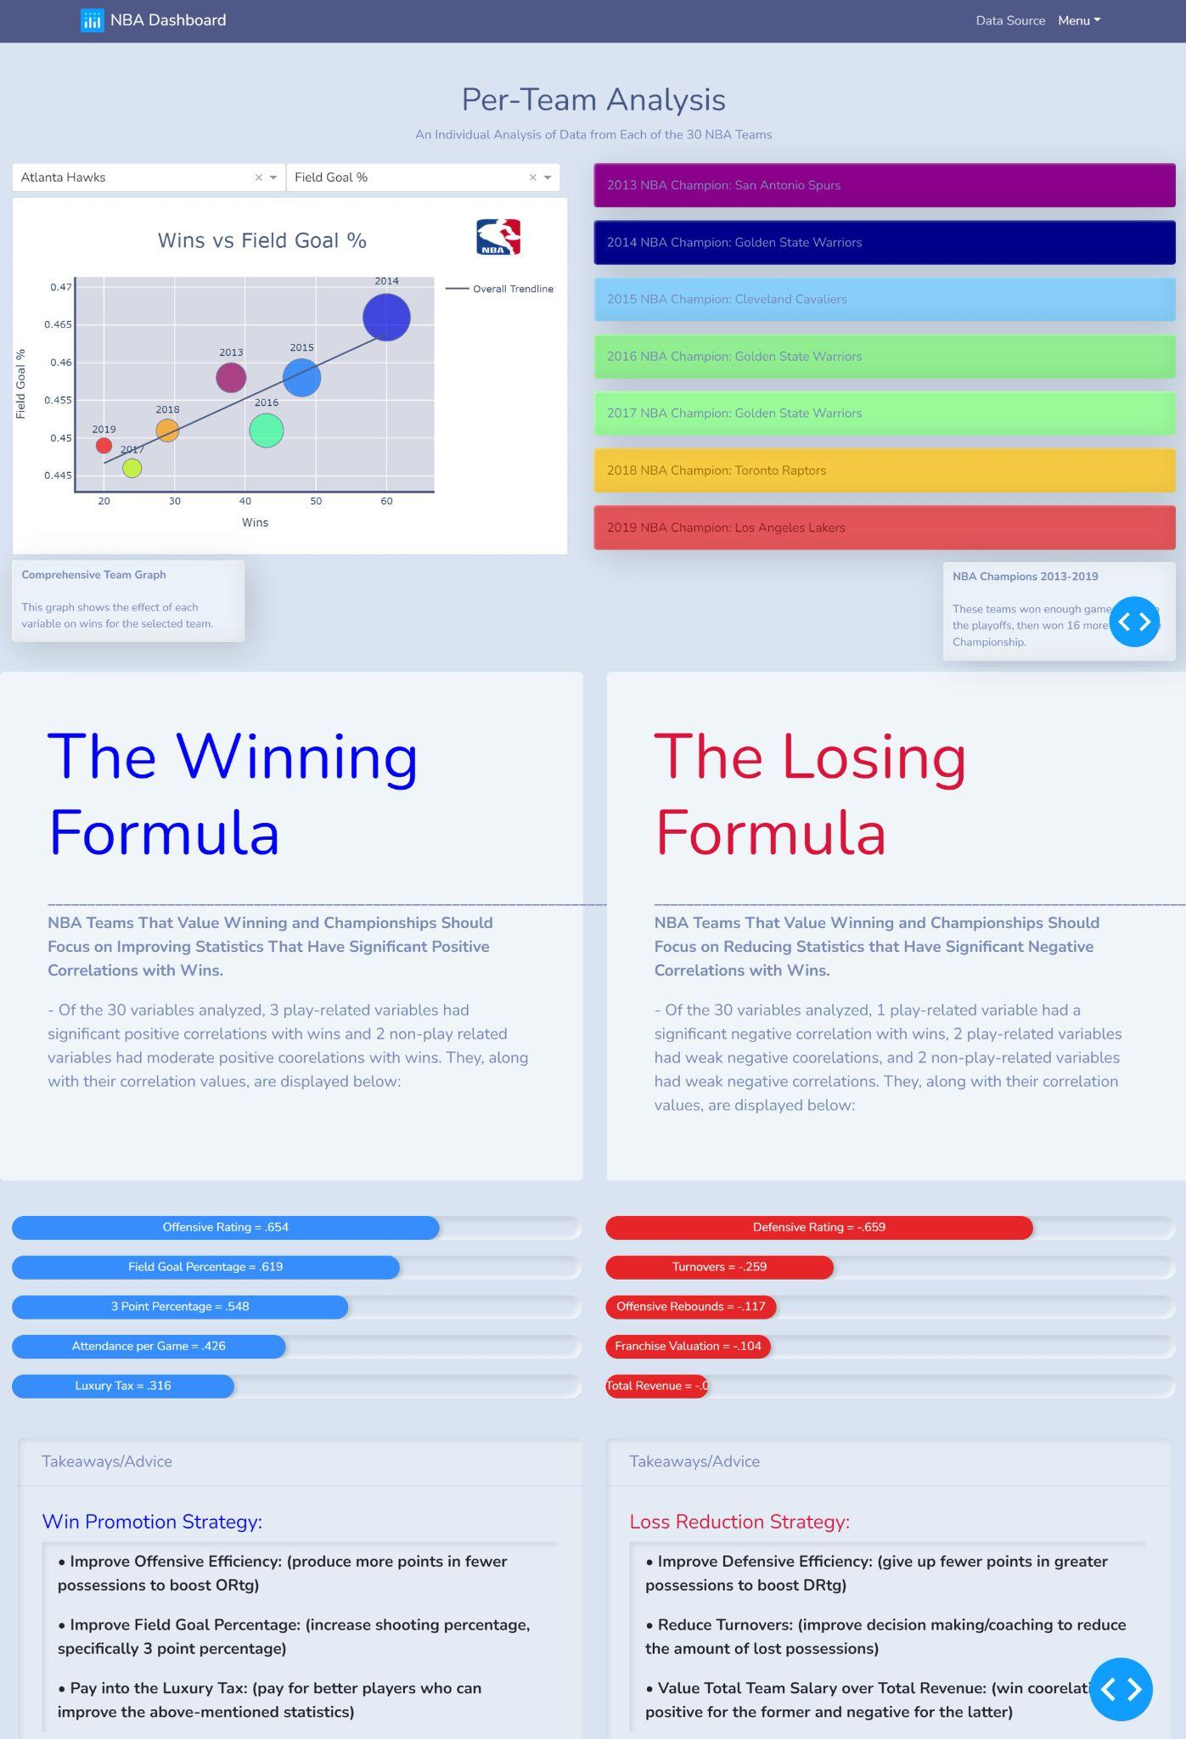
Team Analysis (Page 2)

Slide 28
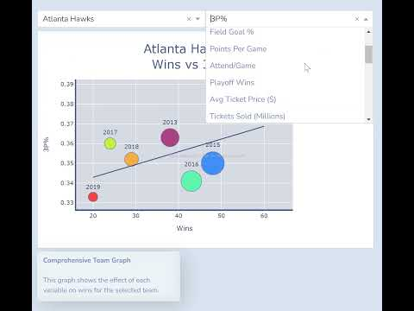
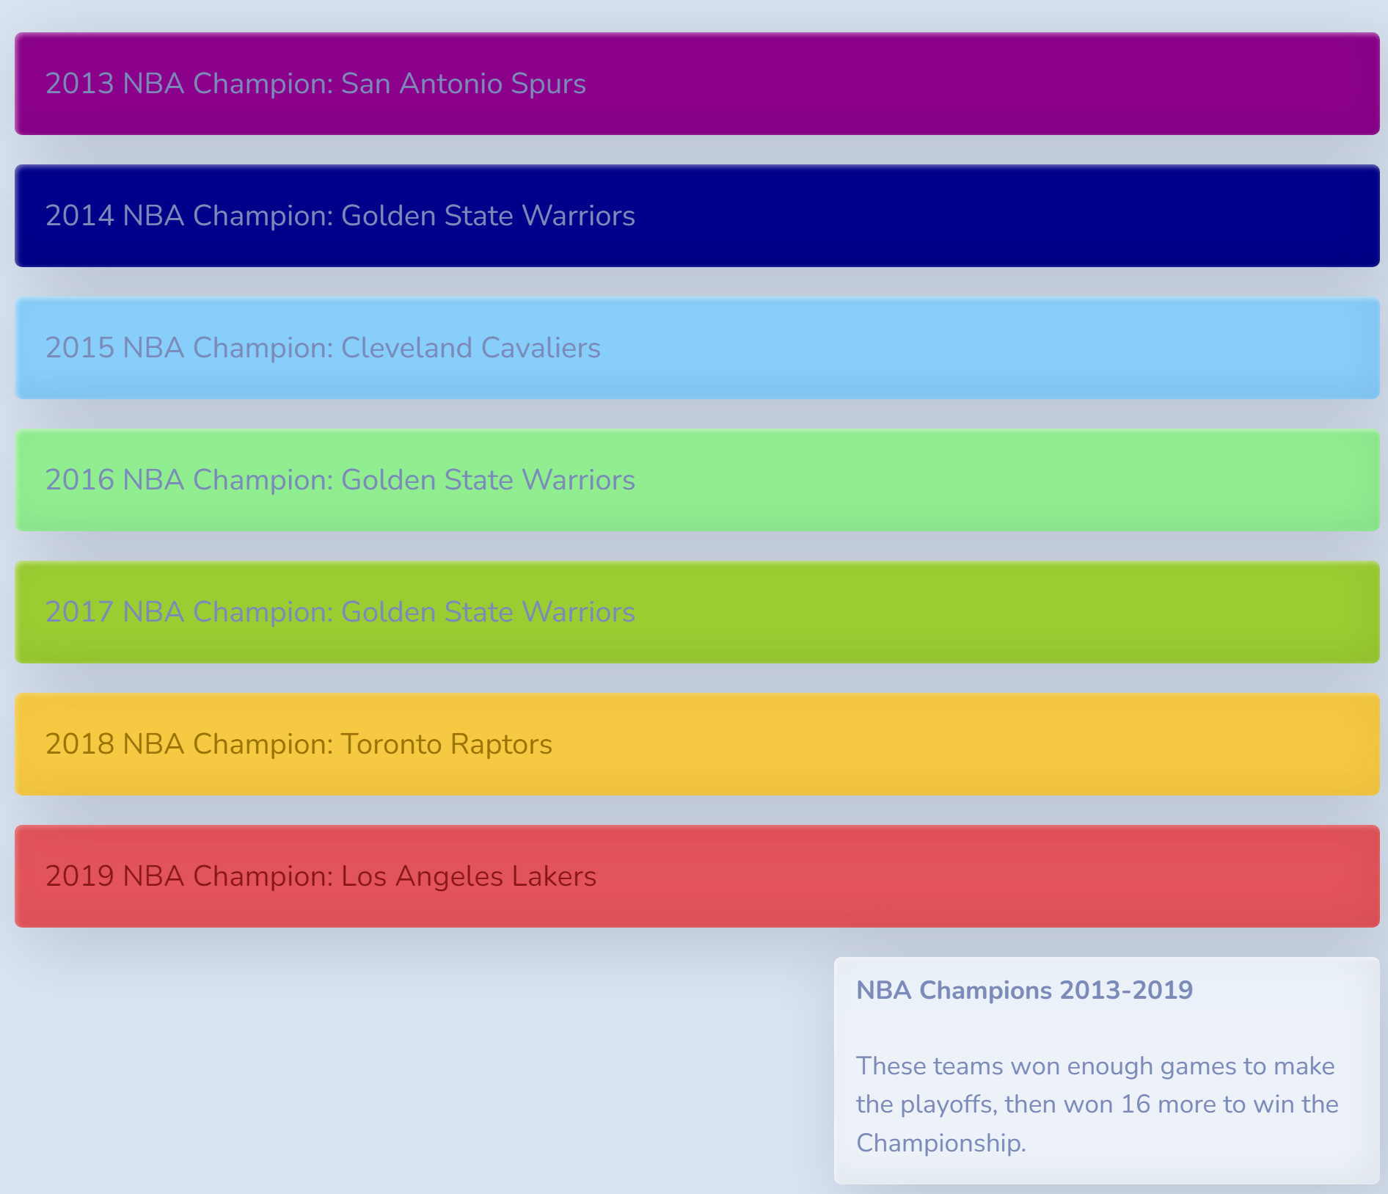
Team Analysis (Page 2)
Video Content:
Comprehensive Per-Team Scatterplot
OLS trendline (Hover: shows Correlation Coefficient)
Scatterplot markers (Hover: display relevant info)
Team Badges:
The right-hand badges show the teams that won the NBA Championship for each season
Each badge color corresponds to the specific year color on the interactive graph

Slide 29
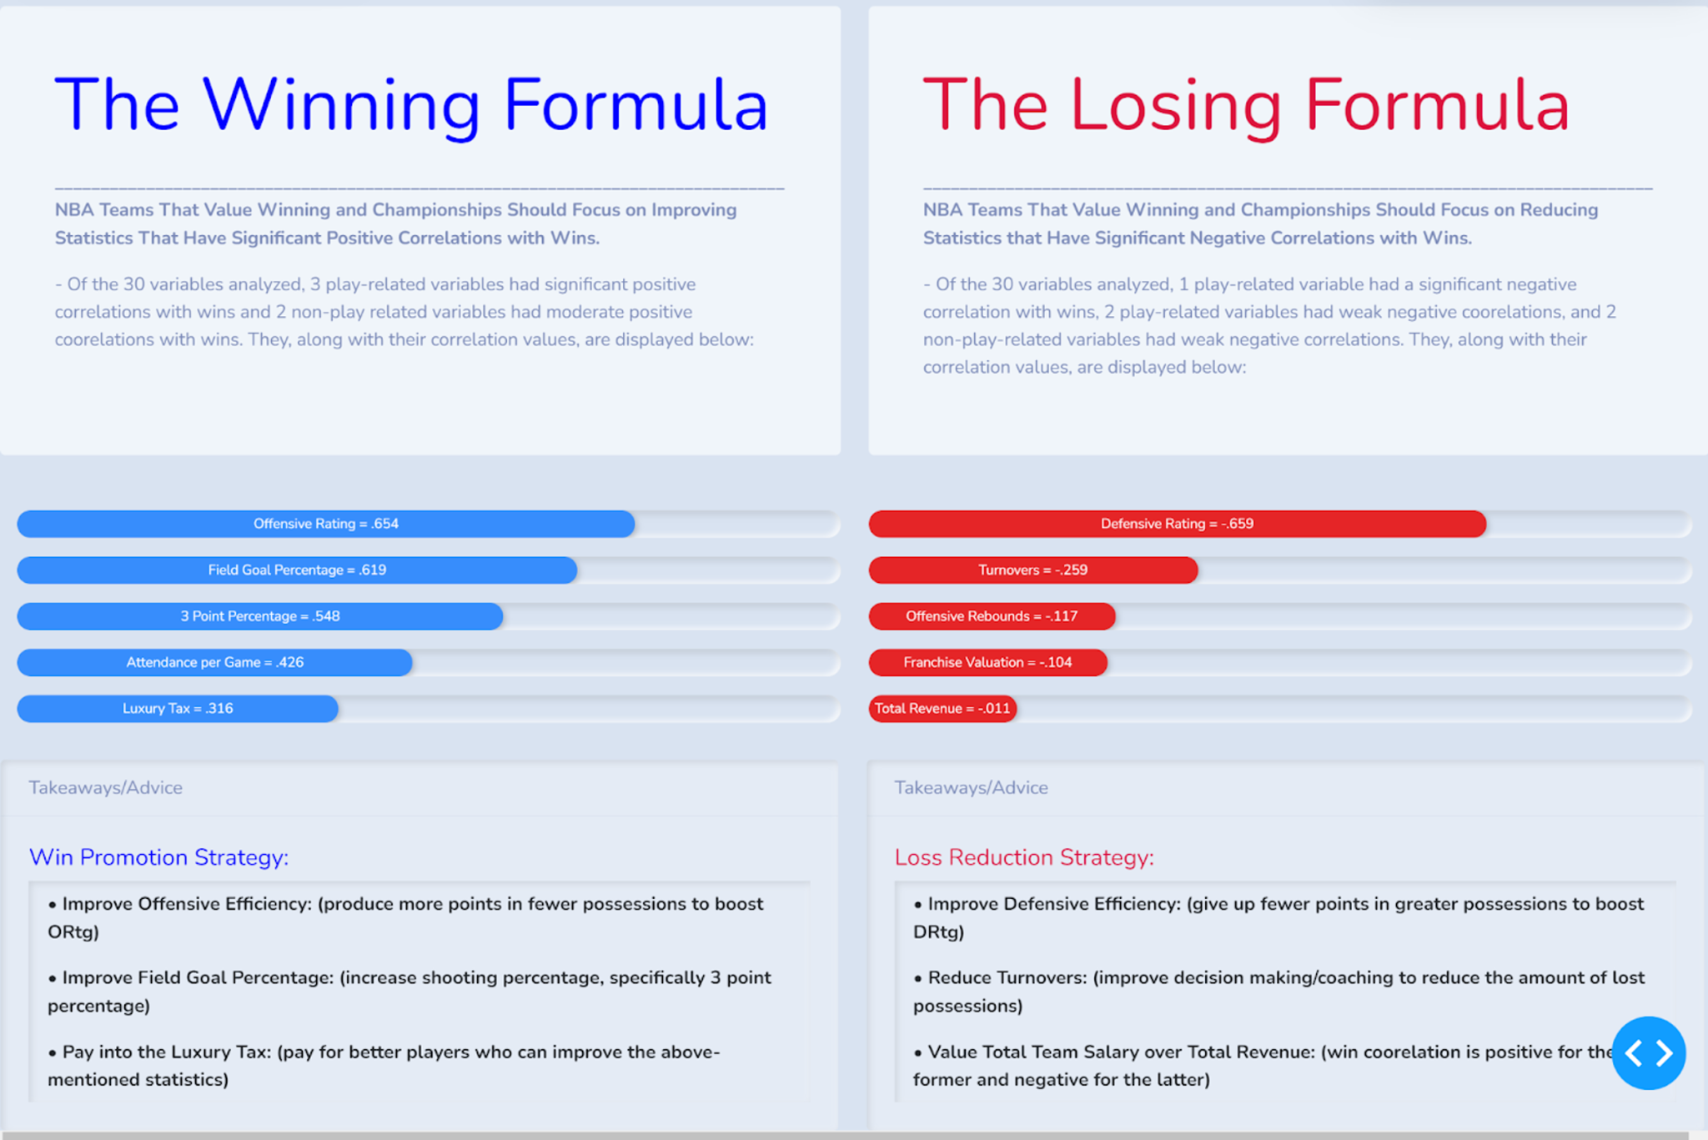
Team Analysis (Page 2) : Conclusion
The Winning Formula
Variables Teams should work on improving in order to have more wins.
3 Play-Related Variables
(Significant Positive)
- Offensive Rating
- Field Goal Percentage
- 3 Point Percentage
2 Non-Play-Related Variables
(Moderate Positive)
- Attendance Per Game
- Luxury Tax
The Losing Remedy
Variables teams should try to reduce in order to have more wins
1 Play-Related Variable
(Significant Negative)
- Defensive Rating
2 Play-Related Variables(Weak Negative)
- Turnovers
- Offensive Rebounds
2 Non-Play-Related Variables
(Weak Negative)
- Franchise Valuation
- Total Revenue

Slide 30
Team Analysis (Page 2) : Conclusion
Win Promotion Strategy:
Improve Offensive Efficiency
Improve Field Goal Percentage
Pay into the Luxury Tax:
Loss Reduction Strategy:
Improve Defensive Efficiency
Reduce Turnovers
Value Total Team Salary over Total Revenue

Slide 31

Data Sources
Primary Data Source:
Clicking the Data Source button directs the user to: https://www.basketball-reference.com/
This was our primary source of data for almost all statistics
Secondary Data Sources:
https://www.latlong.net/
https://www.statista.com/
https://www.spotrac.com/nba/tax/

Slide 32
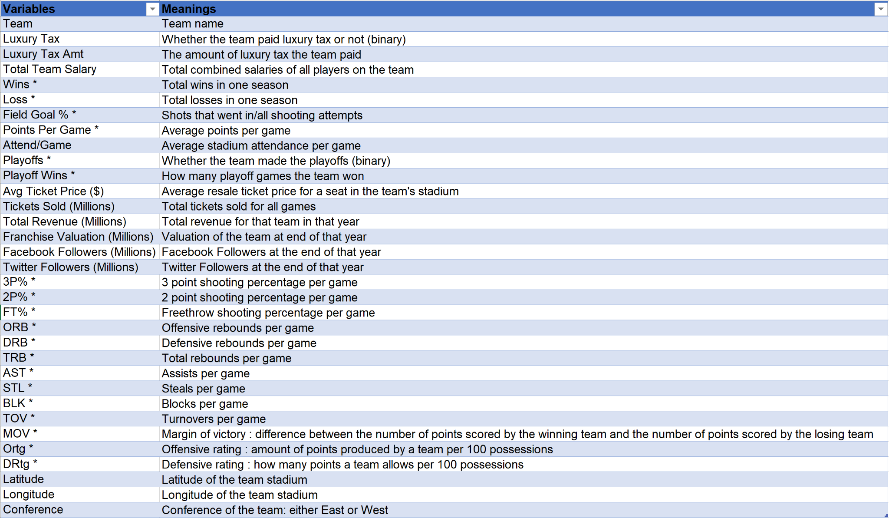
Appendix
Complete Dataset Link (Click)
* Play-Related Variable

Slide 33
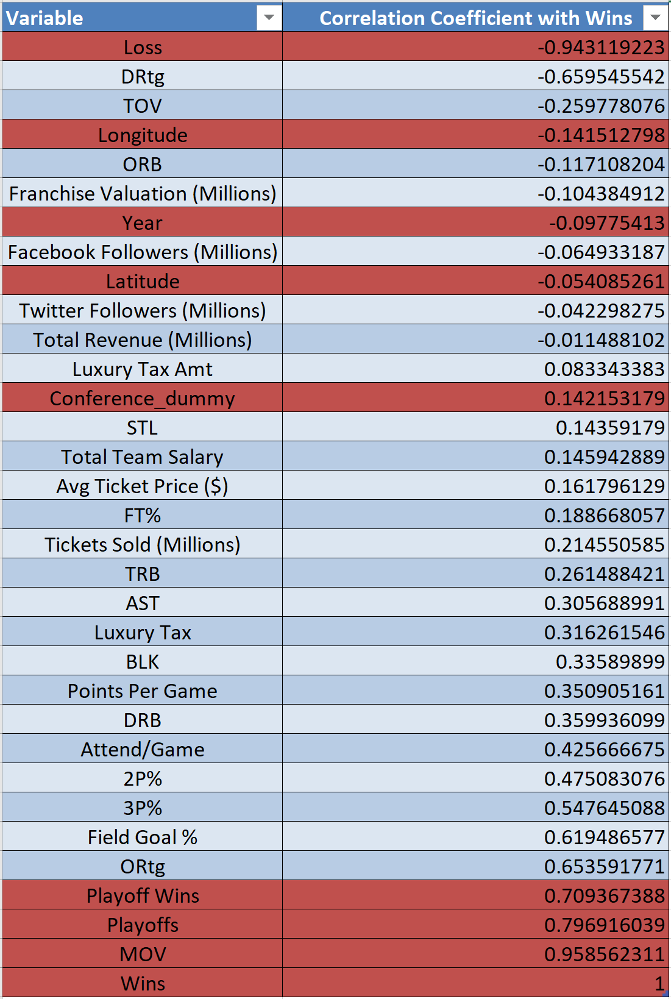
Appendix
Complete Correlation Matrix/Table:
Explanation of red (irrelevant) variables within this correlation table :
Loss: Obvious negative correlation (opposite of wins)
Longitude/Latitude/Conference_dummy: All location-related variables were analyzed using regression
Year: Correlation coefficient for year/season is irrelevant. Analysis of years was done both via grouping and segmentation within the dashboard
Playoffs/Playoff Wins: Ignored these variables as only teams with specific high win totals will make the playoffs
MOV: Margin of victory, by definition, is the amount by which a team wins. MOV’s correlation with wins will obviously be near 1.
Wins: Dependent variable

Slide 34
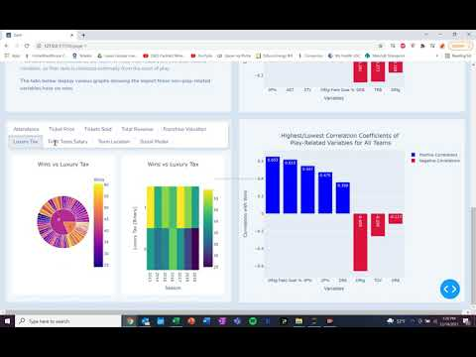
Appendix
Video proof of entire working dashboard:

Slide 35
Thank You!
Notes:
Thank you for your time. We hope you enjoyed our project and dashboard and gained valuable insight into all the factors that affect wins for NBA teams.

